Slide 1
Tour Guiding Course

Slide 2
Introductions
2
Introduce yourself:
Name
Who do you work for?
How many years’ guiding?
Type of guide? E.g. adventure?
What are your hopes from this course?
What are your fears from this course?

Slide 3
Course Programme
3
Module 1: Professionalism
Module 2: Building Rapport
Module 3: Interpretive Activities
Module 4: Tour Management
Module 5: Leadership

Slide 4
Why this training?
4
Tourists expect the same standards all over the world – we need to improve to be at international level
ASEAN countries have set standards for tour guides – Laos has to meet these standards!
These are HIGH standards!!!

Slide 5
Dealing with new ideas
5
Sometimes new things can be difficult to deal with.
The SARA process can help you!
S Shock! At first you really don’t like the idea – you may be upset, or even scared of the new idea
A Anger! You get angry – you want to fight against the idea
R Rejection! You throw the new idea away, and don’t want to have anything to do with it
A Acceptance! After thinking about it for a while, you realise it may be a good thing after all, and you decide to accept it.

Slide 6
Dealing with new ideas
6
This course may give you new ideas – that you may not like at first!
The SARA process can help you think about and accept changes that you can make in your guiding skills!
If you feel uncomfortable in the course with new ideas – ask SARA for help!

Slide 7
Module One
Professionalism in Tour Guiding

Slide 8
Module Overview
8
Topic 1: Professional Behaviour
Topic 2: Responsible Tourism
Topic 3: Research Skills
Topic 4: Tour Guiding Ethics
Topic 5: Brand Representation

Slide 9
Activity 1: Test Yourself – Fun Quiz
9
Go to Page 3 in your Workbook
There is a Quiz there to “Test your Tour Guiding skills”
Read each question and choose the right answer!

Slide 10
Topic One
Professional Behaviour
Appropriate behaviour
Cell phone etiquette
Work and private life

Slide 11
Why Professional Behaviour?
11
Tourists travel all over the world and expect international standards wherever they go - even in Laos!

Slide 12
12
Activity 2: Brainstorm: Western tourist expectations
Expectations!
What are these expectations?

Slide 13
Tour Guide Competencies
13
Tour guide competencies:
Skills, Knowledge, Attitudes
Leadership
General behaviour
Tour management
Knowledge
Guiding skills
Ethics
Responsible tourism
Communication skills

Slide 14
Activity 3: Flashcard Game
14
Take a flashcard
Stand on the left if is a thing tour guides SHOULD do
Stand on the right if is a thing tour guides Things tour guides should NOT do

Slide 15
Do’s and Don’ts: Your Employer
15
Be loyal to who you are working for, e.g.

Slide 16
Do’s and Don’ts: Organisation skills
16
 | Prepare in advance
 | Quick, efficient and organised
 | Be slow, disorganised, lose things
 | Forget important details e.g. name of hotel

Slide 17
Do’s and Don’ts: Time
17
Time
Be on time!
30 mins early
Start on time
Don’t be late!!

Slide 18
Do’s and Don’ts: Tourists
18
Ask pax what they want you to call them: ‘Jim’ or ‘Mr Smith?
Notice pax needs and offer help
Give medicine to tourists
Offend anyone
Argue with tourist, driver or site staff

Slide 19
Do’s and Don’ts: Guiding skills
19
Tell lies or make guesses
Be negative
Take photos while you travel with clients (it’s not your holiday!)

Slide 20
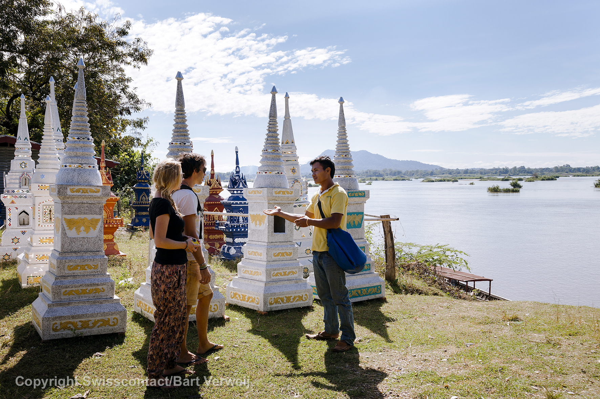
Do’s and Don’ts: Guiding skills
20
Use positive body language
Good presentation skills
Learn how to stand correctly

Slide 21
Do’s and Don’ts: Vehicles
21
In the vehicle: DO
Sit up, be alert, check on tourists
Make sure driver uses cellphone only when needed
Open and close doors for tourists
Help elderly tourists to get on/off
Make sure tourists can find the right vehicle
Make sure air-con is on and vehicle is a comfortable temperature
Count your pax!

Slide 22
Do’s and Don’ts: Vehicles
22
In the vehicle: Don’t
Use your cell a lot, especially personal calls
Talk and laugh loudly and lots with the driver
Text/talk on a cell phone if you are driving
Sleep
Put your feet up on the seat or dashboard
Take your shoes off

Slide 23
Do’s and Don’ts: Meal times
23
Remember when eating & drinking!
Eat with tourists, with good table manners
Make sure tourists have food before you start to eat
Explain why to use as few plastic water bottles as possible
Understand about allergies

Slide 24
Do’s and Don’ts: Meal times
24
Eating & drinking: DO NOT!
Chew gum
Drink alcohol in work time
Smoke in sight of tourists
Eat smelly food close to tourists
Eat smelly foods before talking to tourists – bad breath!
Make loud noises while eating

Slide 25
Do’s and Don’ts: Meal times
25
Table manners:
Action | You | Tourist
Eat open mouthed
Make loud noises while eating

Slide 26
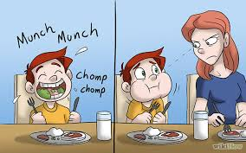
Do’s and Don’ts: Meal times
25
Table manners:

Slide 27
Do’s and Don’ts: Meal times
27
Table manners:
Loud eating noises really upset many Westerners!
Don’t burp in public!!

Slide 28
Do’s and Don’ts: Meal times
28
Food Allergies:
A reaction by the body to certain foods, often nuts (peanuts), flour (wheat flour), seafood, eggs, or dairy (milk) products.
Eating these items can make the person very sick.
Non-food allergies – to animals, insect stings, etc.

Slide 29
Do’s and Don’ts: Meal times
29
Allergies: food and other
Have you ever had tourists with allergies?
How did you handle them?
Watch out for non-food allergies (e.g. bees) when on the tour, so you can keep the tourist away from them.
Keep an allergy chart with pictures to help understand tourists allergies

Slide 30
Do’s and Don’ts: Meal times
30
Common things that people are allergic to:
Nuts (esp. peanuts)
Seafood
Wheat (flour)
Dairy products
Eggs

Slide 31
Do’s and Don’ts: Meal times
31
Allergies: What to do: DMC
Before the tour: Operations department books the restaurant and tells them if any pax are allergic to anything
For big groups:
This will be mentioned at group briefing so the guide will know

Slide 32
Do’s and Don’ts: Meal times
32
Allergies: What to do: Tour Guide
1. Check if any pax have allergies
2. Before you arrive at a restaurant, call to check that they have made special food for the person/s with the allergy
3. In non-booked restaurants, help pax to choose foods that do not contain the ingredients that they are allergic to
4. Ask the restaurant what the ingredients in the dishes on the menu are

Slide 33
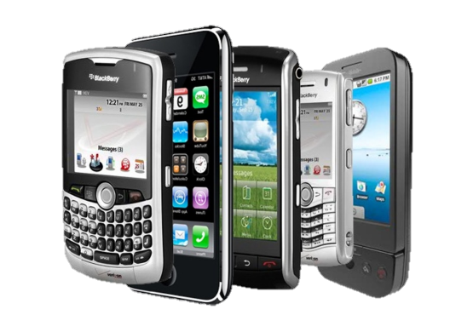
Do’s and Don’ts: Cell phones
33
Good manners with cell phones
Answer professionally and clearly with your name and a suitable greeting
E.g. “Sabaidee, Sone speaking”.
Take business and emergency calls
Excuse yourself to take call
Set your phone to vibrate mode
Set phone with an auto-text message
Give cell phone number to clients
Ask your family/friends to rather sms you while on tour

Slide 34
Do’s and Don’ts: Cell phones
34
Bad manners with cell phones: Do NOT
Answer with only ‘hello/sabaidee’
Take personal calls in work time
Send personal text messages

Slide 35
Do’s and Don’ts: Work and private life
35
Separate your work from your private life!
This is not your holiday – you are WORKING!!
Do NOT:
Do personal shopping/jobs on tour
Bring friends or family along
Take your own photos on tour
Change the itinerary to see something you want to see

Slide 36
Codes of Conduct…
36
“Guidelines on behaviour that are agreed to by a group of guides, usually in a Tour Guides Association”
There is an international organisation to which most tour guide associations belong; the World Federation of Tour Guide Associations.
The WFTGA has an international code for tour guides.
http://www.wftga.org/tourist-guiding/code-guiding-practice - The code of guiding practice

Slide 37
Activity 4: Code of Conduct
37
Working is small groups, make a list of 10 things to include in a Code of Conduct for Laos Tour Guides

Slide 38
Topic Two
Responsible Tour Guiding
What is RT?
Practices of RT in Tour Guiding
What tourists expect

Slide 39
Tourist Expectations
39
First world, European tourists
Used to:
Saving resources
Looking after people
Looking after the earth
Spreading benefits

Slide 40
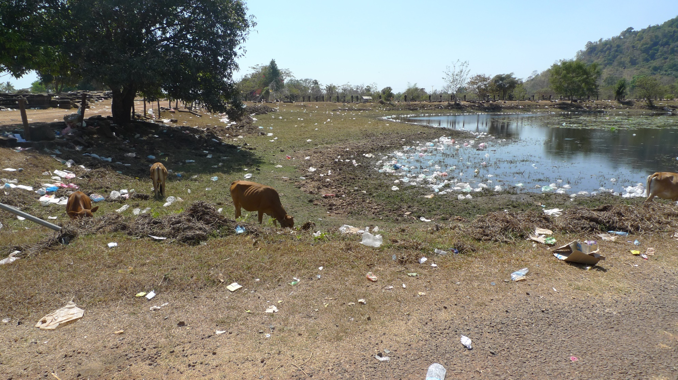
Where was this tourist photo taken?
40
http://shouldvestayedinchorlton.com/2015/02/11/a-laos-me-to-introduce-to-you-4000-islands-and-champasak/

Slide 41
Where was this tourist photo taken?
41
http://shouldvestayedinchorlton.com/2015/02/11/a-laos-me-to-introduce-to-you-4000-islands-and-champasak/

Slide 42
The commentary that went with it:
42
“As we walked up the main road to the site, the whole area was scattered with litter. Crisp packets, cake wrappers, plastic bags, empty bottles… It was post apocalyptic stuff.
‘I’ve never seen so much rubbish, it completely took away from the beauty of the area that was really quite lovely if you could get past the filth.”
‘As environmental conscious human beings, who have had it drilled into themselves from a young age to not litter, it was quite the shock.”

Slide 43
Tourist Expectations: clean environment
43
TripAdvisor Comments: Wat Phou
For all the money they make on the gate why are there no staff picking up litter? The grounds are covered in drinks bottles, crisp packets and plastic bags. Shame. (USA)
The place is way overstaffed and I am not against giving jobs to local people but then they could probably ask 1 of the 10 people standing there doing nothing to pick up the rubbish around the temple. (Aus)
We were extremely disappointed about the conditions in the Unesco site : tons of rubbish everywhere, plastic everywhere, paper everywhere. (Italy)

Slide 44
Responsible Tourism
44
3 elements of Responsible Tourism
Environment
People
Economy

Slide 45
Responsible Tourism: Environmental
45
Responsible Tourism: Environmental

Slide 46
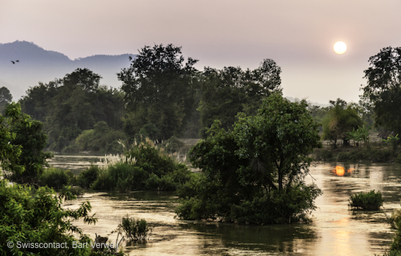
Responsible Tourism: Environmental
46
Key messages:
Protect the earth and everything that lives on it so that we can all live safely and comfortably on the planet

Slide 47
Responsible Tourism: Environmental
47
What are the issues?
Global warming (link)
Water conservation
Biodiversity
Climate Change
Waste management

Slide 48
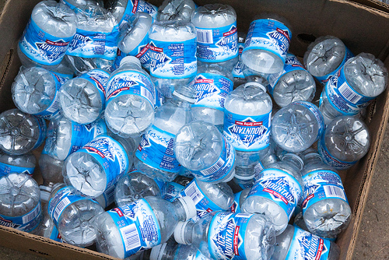
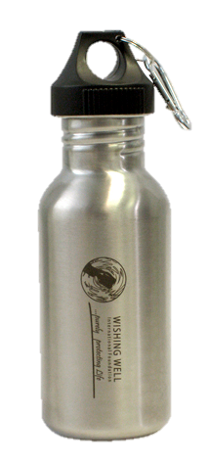
Responsible Tourism: Environmental
48
Waste management: water bottles

Slide 49
Responsible Tourism: Environmental
49
Only take photos Only leave footprints Buy souvenirs or products made from local and renewable products Keep litter to throw away later in a proper garbage can Pick up your rubbish, and even someone else’s! | Take natural items as souvenirs: shells, rocks etc. Buy wildlife products, especially from endangered animals Leave anything behind Damage the natural environment Litter – in any form! Throw anything out of the vehicle window! Waste water Leave electrical equipment on

Slide 50
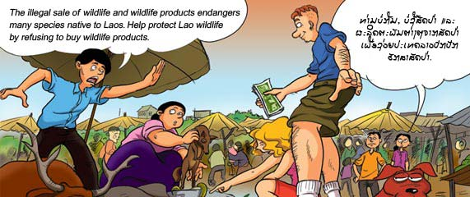
Responsible Tourism: Environmental
50

Slide 51
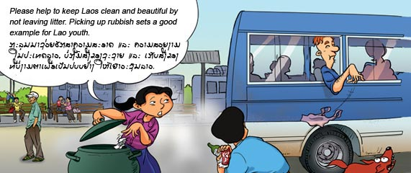
Responsible Tourism: Environmental
51

Slide 52
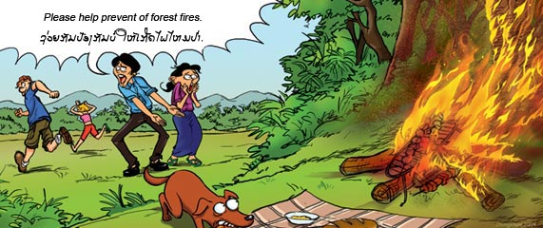
Responsible Tourism: Environmental
52

Slide 53
Responsible Tourism: Social & Cultural
53
Responsible Tourism: Social & Cultural

Slide 54
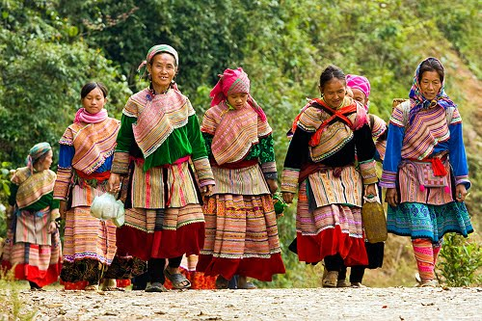
Responsible Tourism: Social & Cultural
54
Key messages:
Respect and protect local cultures and people
Help them where possible in a positive way

Slide 55
Responsible Tourism: Social & Cultural
55
Dress neatly and don’t show too much skin! Dress properly for temples Behave properly Buy new, quality, handmade products not items that belong to the heritage of the country Report sex tourism, especially with children | Touch sacred items/sites without permission Buy antique Buddhas or sacred items Promote or engage in sex tourism, especially with children

Slide 56
Cultural Host
56
You are a ‘cultural host’ for tourists!
How? What to do?
Teach tourists about local cultures in a sensitive way
Introduce tourists to local community without problems
Help local people be comfortable and welcome tourists.
Why? You will help
tourists connect with locals, culture and people
prevent ‘culture shock’
tourists get used to local surroundings and experience.

Slide 57
Responsible Tourism: Social & Cultural
57

Slide 58
Orphanages and Schools
58
Question:
Should or shouldn’t you stop and visit orphanages and schools?
Why or why not?

Slide 59
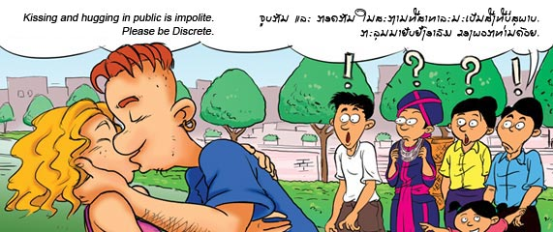
Responsible Tourism: Social & Cultural
59

Slide 60
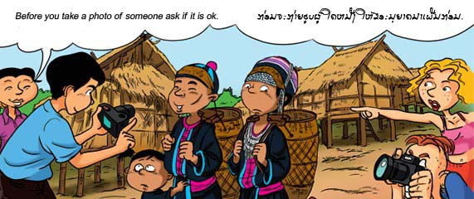
Responsible Tourism: Social & Cultural
60

Slide 61
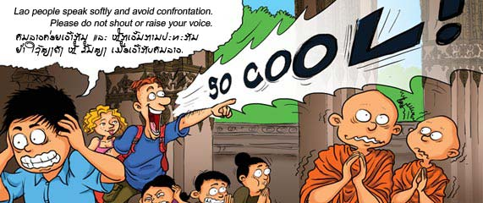
Responsible Tourism: Social & Cultural
61

Slide 62
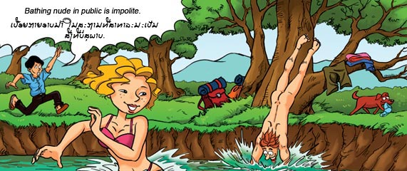
Responsible Tourism: Social & Cultural
62

Slide 63
Responsible Tourism: Social & Cultural
63

Slide 64
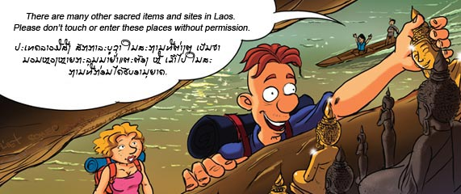
Responsible Tourism: Social & Cultural
64

Slide 65
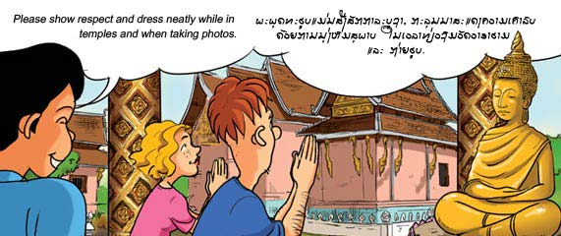
Responsible Tourism: Social & Cultural
65

Slide 66
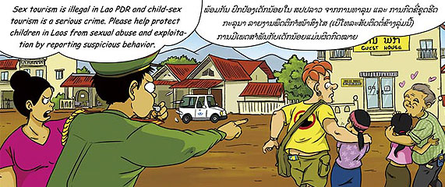
Responsible Tourism: Social & Cultural
66

Slide 67
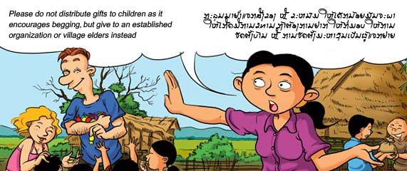
Responsible Tourism: Social & Cultural
67

Slide 68
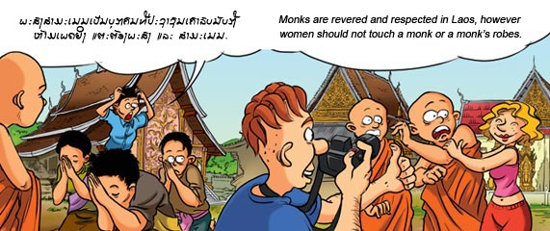
Responsible Tourism: Social & Cultural
68

Slide 69
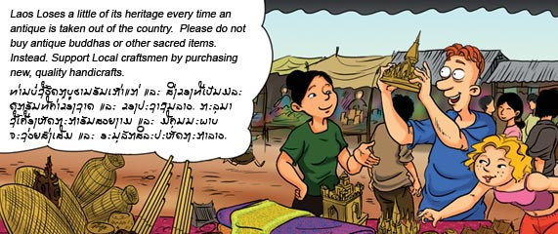
Responsible Tourism: Social & Cultural
69

Slide 70
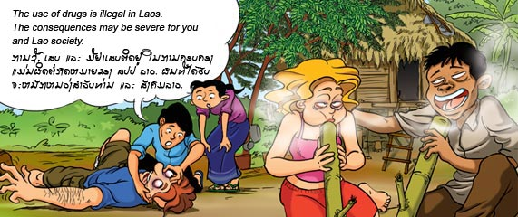
Responsible Tourism: Social & Cultural
70

Slide 71
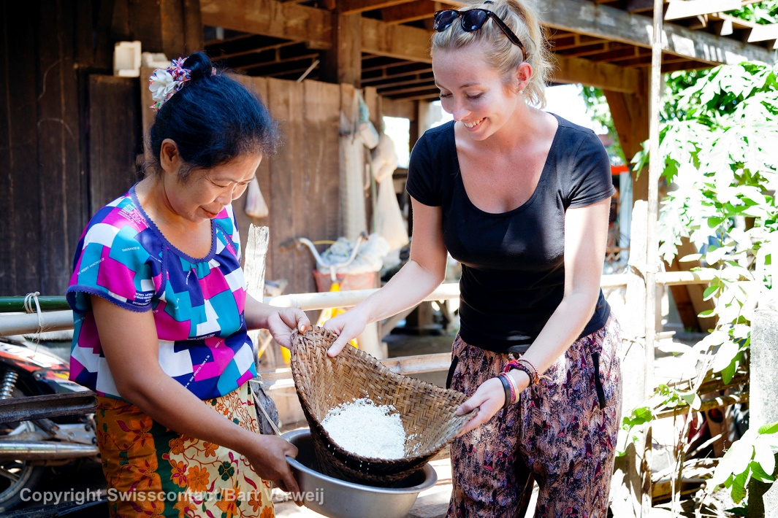
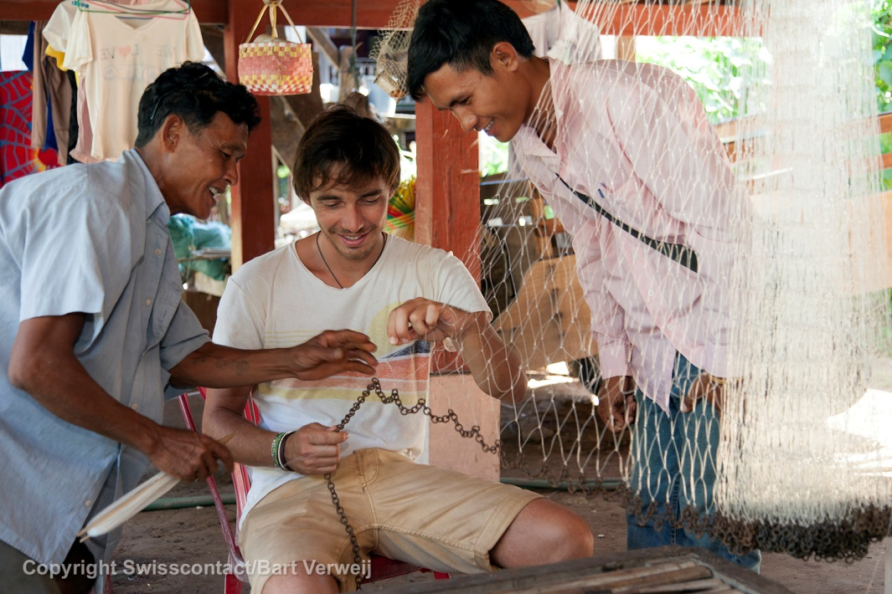
Activity 5: Case Studies
71
Read the case studies given to you.
In small groups, discuss and answer each question.

Slide 72
Responsible Tourism: Economic
72
Responsible Tourism: Economic

Slide 73
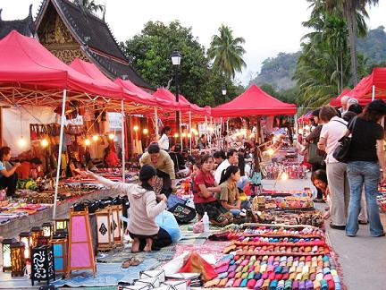
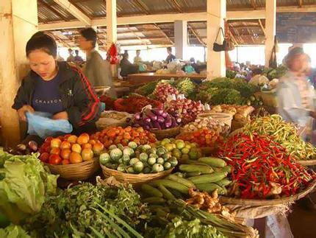
Responsible Tourism: Economic
73
Key messages:
Spend money on local goods and services to spread tourist money to the local people

Slide 74
Responsible Tourism: Economic
74
Suggest tourists buy products or souvenirs that made by local people Eat in local restaurants, shop in local markets, buy local fruit, etc. Buy products that are marked ‘Fair Trade’ | Buy imported products and souvenirs Eat mainly in big or international hotel restaurants Give really large tips or pay too much for something

Slide 75
Responsible Tourism: Economic
75

Slide 76
Topic Three
Research Skills
How to do research
Research tips
Where to find information

Slide 77
Research Skills
77
Why update your knowledge and skills?

Slide 78
Criteria for Research Methods
78
Do not cost too much: spend time rather than money
See what you can do locally: what is available and that you can easily get to
When you update your guiding knowledge and skills, find ways that:

Slide 79
Research Methods
79
How to update Guiding Knowledge
People: Talking & Listening
Reading
Monitoring media & Current events
Field Research
Experts, site staff, other guides...
Internet, travel guides, brochures, books...
Site visits, being a tourist!
Newspapers, magazines, toursim association, TV....

Slide 80
Activity 6: Talking and Listening
80
In groups:
Draw up a list of topics that you talk about when you are guiding
List the people who can help you learn more about these topics
Topic | Who to talk to, to learn more
e.g. History | History teacher or professor

Slide 81
Talking and Listening: Sources
81
Communities
Site Guides
Government Officials
Other Tour Guides
Subject Experts
Tour Operators
Venue Operators
Friends or family
Industry Organisations

Slide 82
Reading: what you can read:
82
Travel Guides
Marketing material
Internet and websites (link)
Airline magazines

Slide 83
Internet Tips
83
Remember: get more info than only found on Google or Wikipedia:
Tourists can also find that!
We want to give them more and better information!

Slide 84
Field Research
84
Visit sites, attractions and destinations
Talk to people who work there
Be a tourist in those locations
Get copies of their
brochures & leaflets
I’m a detective!

Slide 85
Media
85
Travel/tourism sections of newspapers or magazines
Articles and advertisements showing:
new businesses e.g. new hotel, restaurant, tourist activity
changes in products e.g. new restaurant at hotel
Something new and interesting: e.g. bicycle routes

Slide 86
Media
86
Vientiane Mai newspaper, Vientiane Times newspaper (inside back page has a list of events on in Vientiane)
Local newspapers?

Slide 87
Media
87
Listen to local radio to hear about events of interest or any changes in conditions or circumstances
Watch TV – to see travel and tourism programmes and documentaries; new events or conditions

Slide 88
Other ideas
88
Courses Familiarisation Trips
CTAA Tour Guide Association

Slide 89
Topic Four
Tour Guiding Ethics
What are ethics?
Code of Conduct
Ethics for tour guides

Slide 90
What is ethics?
90
Moral principles, standards of conduct, or set of values governing proper behaviour in the workplace

Slide 91
What is ethics?
91
Ethics at Work
Work ethic:
fair and honest work behaviour in return for pay
Business ethics:
honest business practices

Slide 92
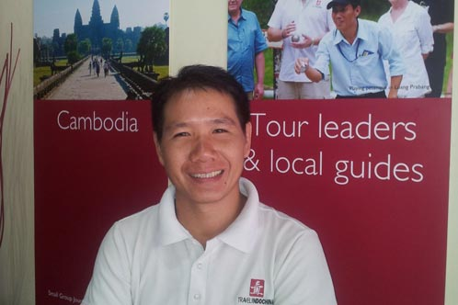
Work ethic for a tour guide
92
Commitment
Being on Time
Loyalty
Pride in Work
Attitude
Respect for employer

Slide 93
Benefits of Good Ethics
93
Have good career
Gain respect
Good reputation
Steady work flow
Earn trust
Happy guests

Slide 94
Consequences of not acting ethically
94
Unhappy tourists
Fewer jobs
Loss of income
Lose respect
Bad reputation

Slide 95
Good and Bad work practices: ethics
95
Arrive and leave on time Behave properly at work Do not talk about guests’ private things Contribute to team work Work all your hours Respect your employer Be loyal to your employer | Show up late/ leave early Gossip Ignore guests Make private calls Talk badly about employer Disrespect your employer

Slide 96
Ethics in Tour Guiding
96
Ethics in Tour Guiding
Content
What you say
Behaviour
How you act
Tour Management
What you organise
How to make sure your facts are true and correct?
All activities are honest: no special commissions, etc.
Honest behaviour

Slide 97
Ethics: Content
97
Be truthful and honest with information given to customers, never EVER make up information
Provide products and services as advertised and promised in the tour itinerary

Slide 98
Ethics: Behaviour
98
Don’t send another guide when you’ve committed to a job!
Don’t pay bribes, take kickbacks
Declare your income for tax purposes

Slide 99
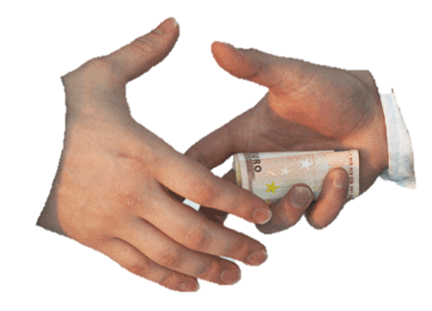
Ethics: Behaviour: Clients
99
Check with the tour company about offering other (private) services to a client: the client belongs to the tour company – not you!
Ask the DMC first before you communicate in writing with tourists

Slide 100
Ethics: Tour Management
100
Don’t change itinerary for your own profit
Don’t cut out activities or stops because of laziness or short days
Provide value for money experiences – give/do what people expect and pay for

Slide 101
Ethics: Guidelines and Tips
101
There is no Book or Rules for Ethics to guide us in wrong or right.
If you are not sure, ask yourself:
If anyone I knew saw me, would I feel OK about it?
Will I hurt anyone by doing this?
Is the decision good for everyone involved?
Is this legal?
Is it against company policy?

Slide 102
Activity 7: Ethical Situations: Case Studies
102
Read the case studies on ethics in tour guiding
In small groups, discuss and answer the questions for each story.

Slide 103
103
Activity 8: What happened to the Lao Royal Family?
A tourist asks you:
“What happened to the Lao Royal family?”
Discuss this in your small groups.
Answer this in a 2 minute talk

Slide 104
Topic Five
Brand Representation
The distribution system
Implications for guides
What is a Brand?

Slide 105
What is a Brand?
105

Slide 106
What is a Brand?
106
A special symbol, mark, logo, name, word, sentence or a mix of these items that companies use to separate their product from other products

Slide 107
What is a Brand?
107
Brand Symbols

Slide 108
What is a Brand?
108
Name

Slide 109
What is a Brand?
109
Word or sentence

Slide 110
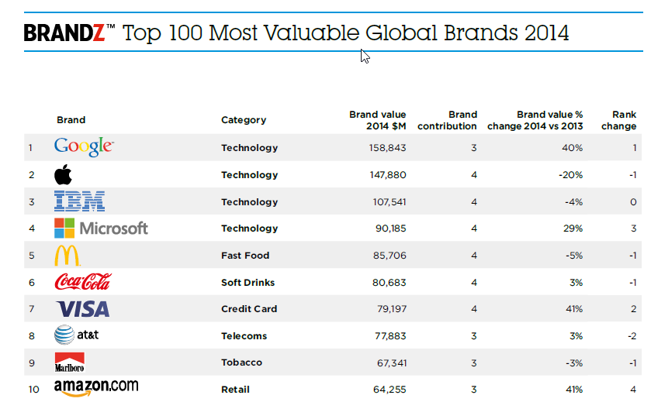
Top 10 brands in the world – recognise them?
110
content

Slide 111
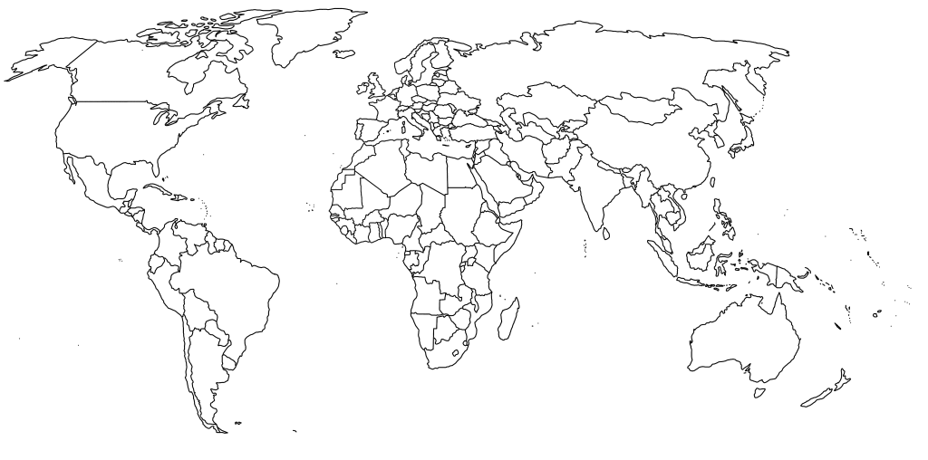
International Distribution
111
African partner
Latin-American partner
International partners for Insider Journeys: world-wide

Slide 112
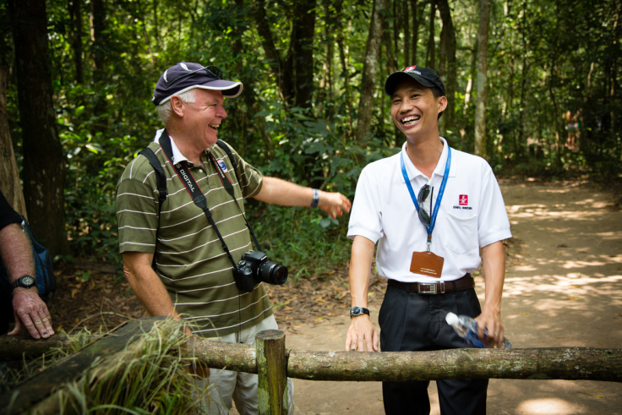
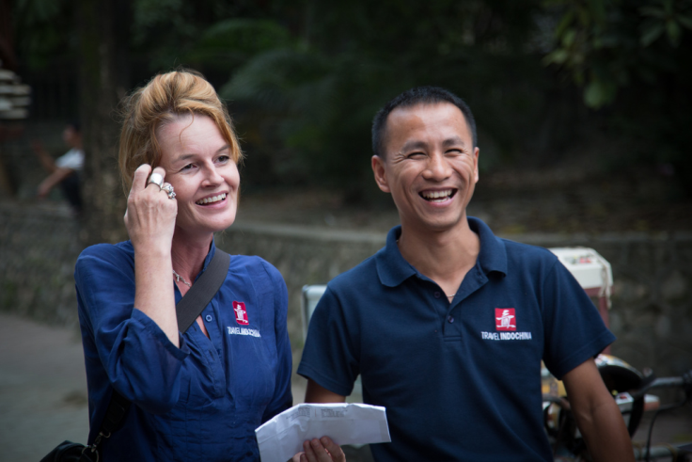
What this means for the guide??
112
Tourists travel across the world, often with the same tour operator.
They expect the same standards everywhere they go

Slide 113
Tour Operation in Laos – who fits where?
113
International Tour Operator
Destination Management Company
(Laos-based tour operator/travel agent)
Destination Management Company
(Laos-based tour operator/travel agent)
The tour package
Tour Guide
Hotels
Tour Guide
Hotels
Restaurants
Transport
Attractions & Activities

Slide 114
Distribution Systems
114
Which brand is the tourist buying?

Slide 115
Distribution Systems: example
115
Who do you work for?

Slide 116
Who employs you?
116
The guide works for two organisations:
The sales market brand
The brand that the clients have bought and need to see they are getting.
The employing organisation
The local tour operator who contracts the guide, and who you send invoices to and get paid by

Slide 117
The DMC Brand: example: Travel Indochina (TIC)
117
Contracting of suppliers, including guides, done by TIC
Reservations done by TIC
Invoices sent to TIC
Invoices paid by TIC
Destination Management Company
(Laos-based tour operator/travel agent)
The tour package
Tour Guide
Hotels
Restaurants
Transport
Attractions & Activities

Slide 118
The International TO Brand: example: Insider Journeys
118
For Insider Journeys tours and groups:
Use IJ branding
IJ airport transfer boards
IJ vehicle magnets
IJ guide & driver uniforms
IJ welcome kits & surveys
IJ airport transfer slips

Slide 119
Brand Standards
119
Each contracting international TO has its own brand and brand standards:
Standards of care, information and guiding
Operating procedures
Livery (uniform)

Slide 120
Activity 9: Brand Styles
120
Working in small groups, identify the travel brands that you work for in Laos.
What is the special style of these brands?
What do you think about when you hear or see that brand name?
What makes them different from other tour operators?

Slide 121
International Travel Brands in Laos
121
Overseas Adventure Travel
Green Discovery Tree Top
Disney (tours)
National Geographic (tours)
Audley
Footsteps in Asia
Contiki
Cox & Kings
Flight Centre (Australia)

Slide 122
What this means for the guide??
122
International guiding standards: must be same in Latin America, Africa and Laos: the reputation of the international TO is at stake!
Standard operating procedures
Specific documents – forms, checklists, etc.

Slide 123
What this means for the guide??
123
Dress and uniform:
Branded name badges
Branded shirts, caps, jackets
Correct colour trousers/skirts and shoes
Livery items must be clean and in good condition

Slide 124
Consequences of not using the right brand
124
Confuses the client
Creates an image of unprofessionalism

Slide 125
Conclusion
Interpretive Activity
Module Summary
Next Module

Slide 126
Assignment: Steps
126
1
Choose a topic
2
Research the topic
3
Choose an Interpretive Activity to present that topic to tourists
4
5
Develop and prepare the Interpretive Activity – use the Planning sheet
Present the activity in class on Day 5

Slide 127
Choose your topic
127
Choose the topic that you are going to learn more about. Research and submit it to your trainer – NOW!
The topics are on the next slide

Slide 128
Assignment Topic to choose from
128
Fishing methods on the Mekong
A day in the life of a monk
Coffee: from tree to cup
River Life
The Rocket Festival
Market tour
Musical instruments
Mango paper
Street Food of Pakse
Birds in Champasak

Slide 129
Module Overview
129
Topic 1: Professional Behaviour
Topic 2: Responsible Tourism
Topic 3: Research Skills
Topic 4: Tour Guiding Ethics
Topic 5: Brand Representation

Slide 130
Module Two
Building Rapport

Slide 131
Thank You! Kop Chai!

