Slide 1


Module Five
Leadership

Slide 2

Module Programme
2
Topic 1:
Solve Problems and Make Decisions
Topic 3:
Handle Unexpected Events
Topic 4:
Handle Complaints
Topic 2:
Look for & Manage Risks

Slide 3


Activity 1: Problem Solving Games
3
Do the problem solving puzzles in your
learner book.

Slide 4

Topic One
Solve Problems and Make Decisions
Decision Making Process
Your different responsibilities
Report problems and decisions

Slide 5
Follow protocols!
5
Remember: Tour Operator Procedures
1. First call the Ops Manager to report and discuss the problem and options
They may have ideas/ solutions you don’t know about
They are there to guide and help you!
They may see legal or cost problems with your ideas

Slide 6
Follow protocols!
6
Remember: Tour Operator Procedures
Call especially if the solution involves money!
Don’t call for small problems that you can solve right there – like guest who wants a different room
For a road accident, or a flat tyre – call operations so that they know about the problem

Slide 7
Decision Making Process
7
1. Find the problem
2. Think of solutions
4. Choose a solution
5. Implement/ do the solution
6. Evaluate the solution
3. Evaluate the solutions

Slide 8
Remember!!!
8
Tell the clients informed what is going on!!
Asian People
Are happy to let things happen around them/ without knowing
Western People
Want to know what is going on/ how long/ when fixed, etc.

Slide 9

1. Find and understand the problem
9
What is the problem?
What caused it?
When you understand this – you can think about solutions

Slide 10

2. Think of a few possible solutions
10
The more solutions you can think about, the better your chance to solve the problem.
Solutions
1
2
3
4

Slide 11


3. Evaluate the solutions
11
What is good (pros) or bad (cons) about each solution
Options | Pros | Cons
Solution 1
Solution 2
Solution 3
Solution 4

Slide 12

4. Choose the best solution for the best result
12
Look at the positives and negatives of each solution and choose the best one
Call head office
Get permission to do it

Slide 13

5. Implement/ do the solution
13
Do the plan that you chose

Slide 14
6. Check if the solution works
14
Check with
  tourists or
  service providers that help to fix the problem
Check that everything is going as planned and in the process of being fixed

Slide 15
Always
15
Call Operations!
Keep clients informed!

Slide 16
Activity 2: Problem Solving Case Studies
16
Divide into small groups
Read the problem solving scenario that your group got
Use the problem solving process to solve the problem
Shortly explain the problem and your solution to the class

Slide 17
Handle problems with tour group members
17
When you deal with problems remember:
Ask for help or back-up from management, other staff or security if you need it
YOU control tour – the tour group members don’t control it

Slide 18


Handle problems with tour group members
18
Problems don’t fix themselves: YOU have to fix them!
Give reasons for them to stop wrong behaviour:
Safety: it may not be safe
It stops the enjoyment of the whole group
If you show people what they do is not safe, they may listen and respond better

Slide 19
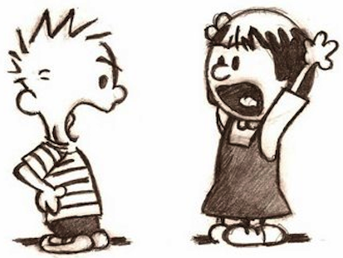
Handle problems with tour group members
19
Be respectful
Stay calm
Talk politely

Slide 20


Handle problems with tour group members
20
Choose words carefully - NOT a personal ‘attack’
“We prefer not to do things like that on tour/here”
“Don’t do that!”
Ask, don’t tell!
“Could I please ask you not to do that because it is disrespectful to the local people?”
“You must not do that”

Slide 21
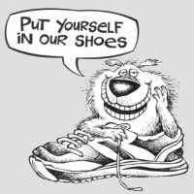
Handle problems with tour group members
21
Try to see things as they do.
Consider saying:
“I can see you are tired and I know we walked quite a long way and it is hot, but I need you to know it is not acceptable/good for the safety of the pax if you wander off on your own to have a rest”

Slide 22

Handle problems with tour group members
22
Take both parties away and talk to them together
Long tour:
Try to solve the reason for the problem
Ask what the problem is:
It helps you to understand and for parties to talk about it
Short tour:
Try a quick solution until the tour ends

Slide 23

Handle problems with tour group members
23
Explain how bad action stops pax enjoyment
Thank people for their cooperation
Ask them to stop the thing that disrupts the tour
Give ideas for other solutions – allow them to choose the option they like best
Give solution ideas
Ask again for them to behave in a different way
Ask parents to look after children more closely/better
Keeping looking at the situation
Let people sit in different places (away from each other)
Put people in different groups so there is less conflict in viewing, activities, dining etc.

Slide 24
Activity 3: Cross Cultural Problem Solving
24
Each participant must take 1 problem scenario and come up with solutions
Tell the class what the problem is, and give ideas on how to handle it

Slide 25
Topic Two
Identify and Manage Risks
What is a Risk
Types of Risks
Managing Risks

Slide 26
Activity 4: Cell Search: ‘Risk’
26
Use your mobile phones, look for the meaning of the word “risk”
Give a short explanation of what a risk is
Give at least 5 risks that you can recognise in the tours you guide

Slide 27
What is a “Risk”?
27
A risk is:
A situation where there is possible danger
A probability (may happen) or threat of damage, injury, loss, or any other negative things that are caused by external or internal weakness, and that could be stopped with proactive (before it happens) action

Slide 28
What is a “Risk”?
28
Part of the definition | What it means:
A probability or threat of | Something bad can easily happen
Damage, injury, liability, loss, or any other negative effect | This harm to people or property in some way
caused by external or internal weakness | It will happen because there is not enough protection against the threat
May be avoided by taking | It can be avoided/stopped IF
Pro-active action | Take steps to avoid/stop it

Slide 29
Your job as a tour guide is to
29
1. Identify/look for threats that may harm people or property
2. Check how strong these threats are – what is the chance of the damage happening
3. Identify (look for ways) how it can be avoided/stopped
4. Implement action (do something) to avoid/ stop it.

Slide 30
Why manage risks?
30
Avoid legal action: sued for damages
Protect the safety of tourists, staff, public and community
Prevent/stop damage to a site
Protect the environment
Keep property safe
Run activities safely
Protect the reputation of the Tour Operator

Slide 31
Types of risks depend on
31
The type of tour: e.g. adventure vs. cultural tour
Where you go: the destinations visited
What you do: activities being conducted

Slide 32
Types of risks depend on
32
Size of the group: more people will be more difficult
Who is in the tour group: profile
Weather and local environment

Slide 33
How to manage risks
33
1. Identify Risk
2. Assess Risk
3. Control Risk

Slide 34


1. Identify Risks
34
Ask yourself:
What can go wrong?
Are there dangers or hazards?
Have you ever been in a similar situation (like it) before? What happened?
Can you learn from other incidents or similar situations?

Slide 35
1. Identify Risks: Environmental Conditions
35
Weather
Temperature
Time of day

Slide 36
1. Identify Risks: Environmental Conditions
36
Conditions e.g. roads
Physical dangers
Animals or insects

Slide 37
1. Identify Risks: Group Characteristics
37
Group size
Pax health and what they can/ can’t do
Personal Protective Equipment PPE
Lessons learned – other accidents

Slide 38
Activity 5: Identify and Manage Risks
38
Read the tour description
Look for any risk that could happen with tour members on this tour.
How can you manage these risks?

Slide 39
2. Assess Risk: How bad is the risk??
39
Judge
Impact
Likelihood

Slide 40
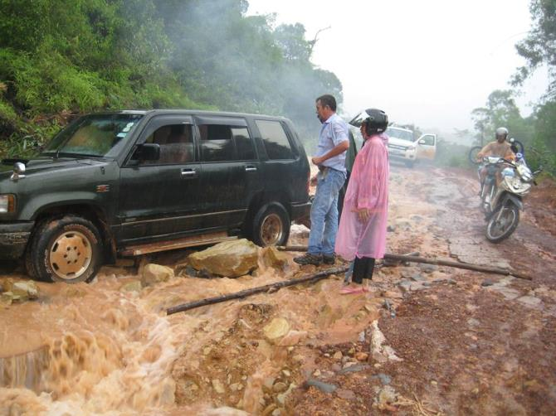
2. Assess Risk: Risk Impact
40
The impact: what happen?
How serious will the effect be?
How bad?
Injuries?
Death?
Damage to property?

Slide 41
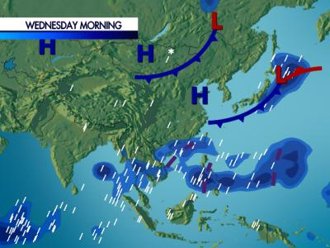
2. Assess Risk: Risk Likelihood
41
The likelihood (what’s the chance?):
Will it really happen?
What is the possibility/chance of it happening?
How can you predict?
E.g. weather forecasts,
experience, etc.

Slide 42
2. Assess Risk: Risk Matrix
42
High | Medium | High | Very serious
Medium | Low | Medium | High
Low | Low | Low | Medium
 | Low | Moderate | High
Impact
Likelihood
Impact
Likelihood: will it happen?

Slide 43
2. Assess Risk: Risk Matrix Key
43
Low Risk: don’t worry too much, it probably will not happen, and if it does, there wont be too much damage
Medium Risk: there is a possibility that this will happen, and if it does, there will be some damage
High Risk: there is a real possibility that this will happen, and if it does, there will be some nasty damage or injury.
Critical Risk: the risk is very bad – and is going to happen When it does there will be very bad damage, possibly death.

Slide 44
Activity 6: Identify Risks
44
Work in groups
Use the matrix and pictures that you get from the trainer
Do a risk assessment of the 3 situations in your workbook

Slide 45
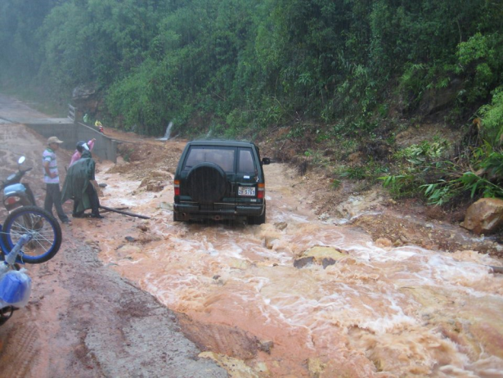
Communicate!
45
Remember: one of the first things you need to do is explain the possible danger to your group
This will help them to understand what is going on, and that you have to make a decision to keep everybody safe

Slide 46
Communicate!
46
Demonstrations: e.g. equipment
Practice safety procedures:
e.g. evacuation
Give safety info and advice to pax:

Slide 47
2. Control Risk
47
What to do?
Where to get help…
Advice from other people
Procedures and regulations

Slide 48
Other people
48
Operations Manager
More experienced tour guides
Other tour operators

Slide 49
Procedures and Regulations
49
Standard operating procedures (SOPs) from tour operator
Checklists or guidelines
Laws and regulations

Slide 50
Control Risk: What to do: Options
50
1. Remove risk
2. Replace with a safer option
3. Isolate risk
4. Make changes
5. Use PPE (Personal Protective Equipment)

Slide 51
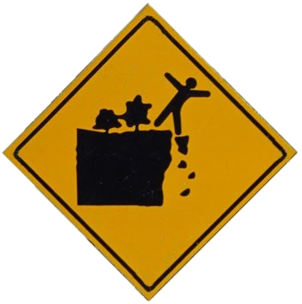
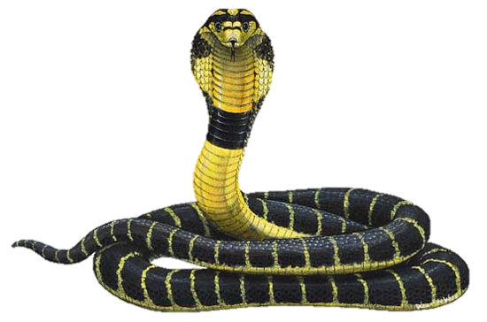
Remove the Risk
51
Remove the risk hazard or threat/danger:
Best, most effective and first choice to manage/control risk

Slide 52
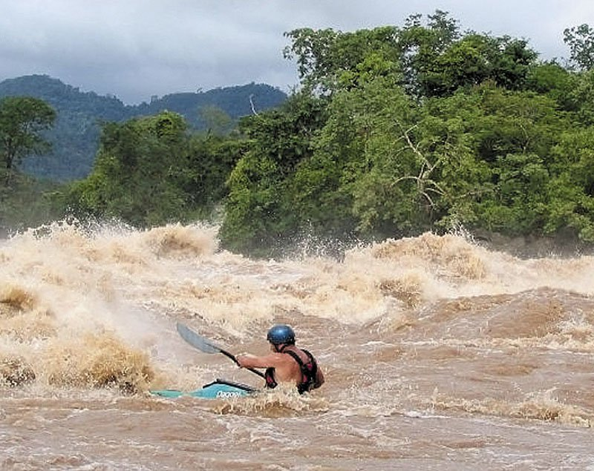
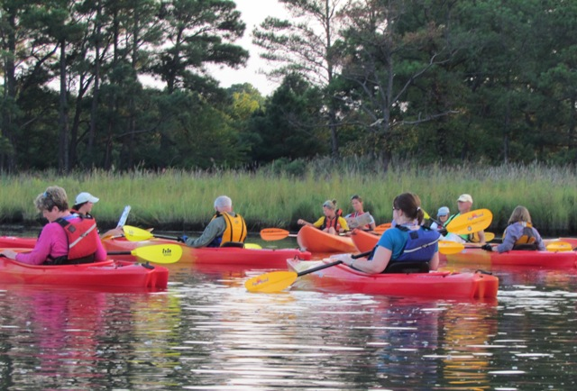
Replace the Risk
52
Replace a dangerous activity with a safer one that still is a similar experience

Slide 53

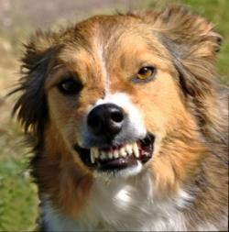
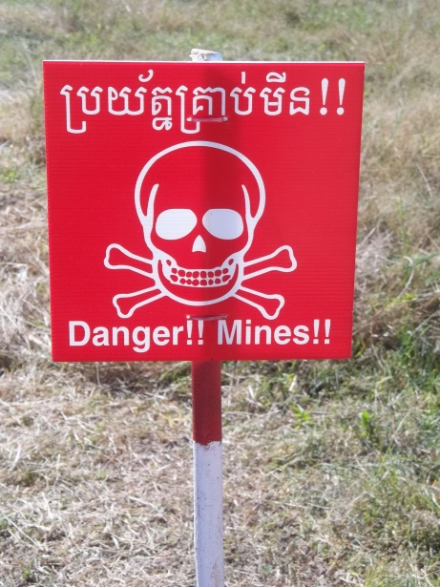
Isolate the Risk
53
Isolation: create a distance between a danger and the tourists: e.g.
move them a safe distance away
place a protective barrier/shield between them and the risk source

Slide 54
Make Changes
54
Change the way you do things, or change the equipment or tools used in the activity to make things safer. E.g.
Smooth out uneven ground
Limit the number of people taking part at any one time
Manage the number and group size for an activity
Closely watch and monitor activities

Slide 55
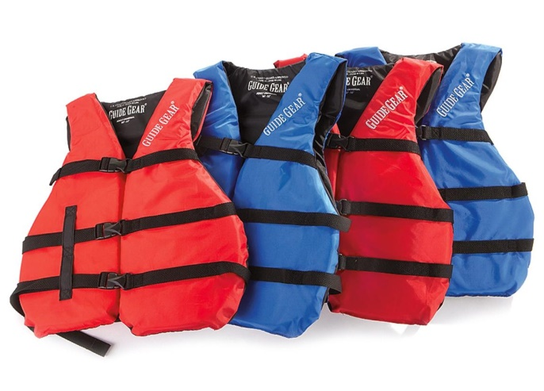
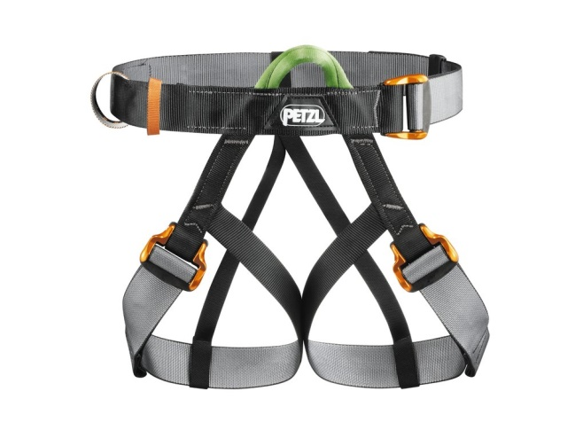
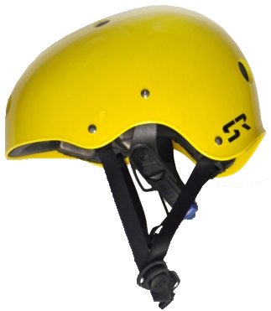
Use PPE
55
Personal Protective Equipment:
NB for Adventure Sports!
Supply and use items and clothing to provide protection, e.g. gloves, footwear, eye protection, helmets, harnesses, etc.

Slide 56
General Risk Management Guidelines
56
Follow health or safety procedures: e.g. wear lifejackets on boats
Watch and check that your instructions are followed – e.g. keep life jackets on at all times on the boat!
Give help and guidance if it’s needed

Slide 57
General Risk Management Guidelines
57
Tour members behave sensibly and safely – e.g. don’t hang out over the edge of boat
Control dangerous behaviour
Tell pax to stop doing anything that can be dangerous to themselves and/or other people.

Slide 58
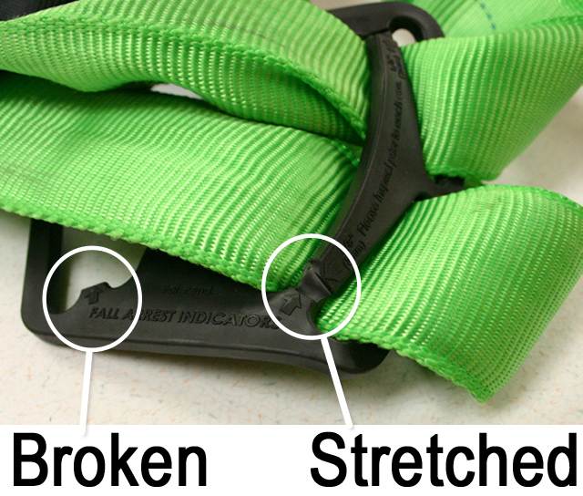
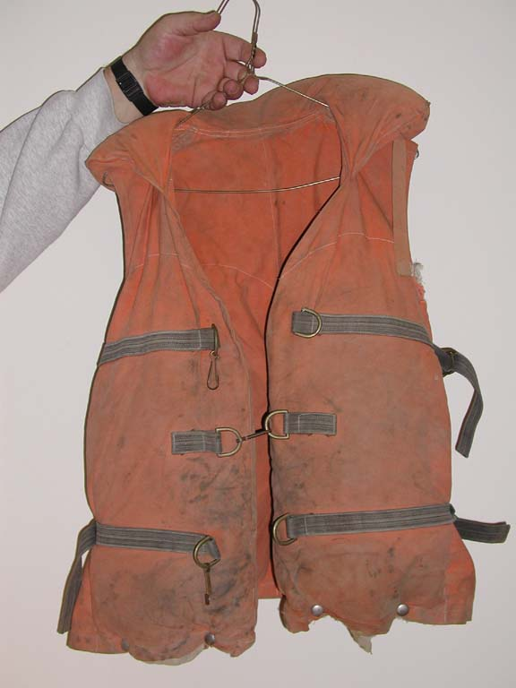
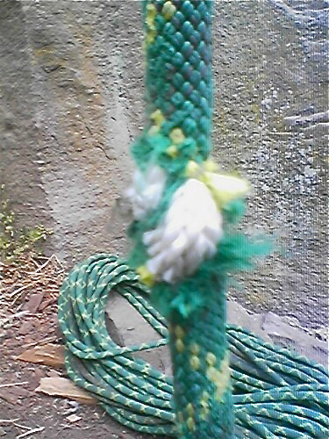
General Risk Management Guidelines
58
Check equipment, places you go, facilities and the environment – before use so you understand if there are threats or dangers.

Slide 59
General Risk Management Guidelines
59
Know your emergency responses to different emergency situations – e.g.
Man overboard
Boat capsizes
Accident
Injury

Slide 60


General Risk Management Guidelines
60
Stop if you cannot keep people safe
Remember to meet company policy about paying back any tour fees

Slide 61
Risk management
61
Never just believe participants will see even most obvious risks or know:
what to do to cope with dangers
how to avoid damage or injury
how to protect themselves or their property

Slide 62
Topic Three
Handle Unexpected Situations
Identify unexpected situations
Develop contingency plan
Carry out contingency plan

Slide 63
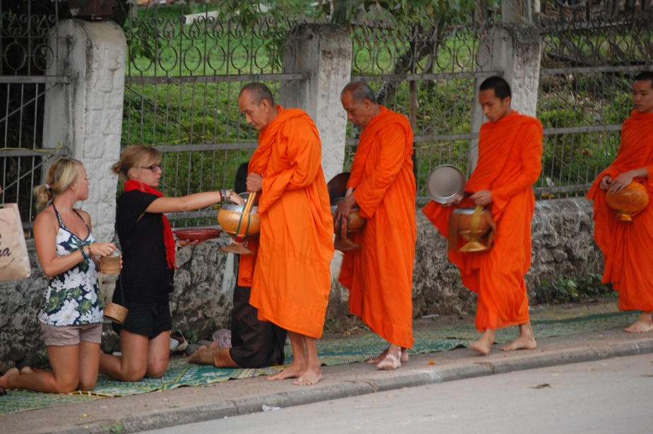
Type of unexpected events
63
An unexpected event is something that you have not planned for
It will impact on the itinerary and the tour planning
It affects other activities

Slide 64
Types of unexpected events
64
Negative events
Accidents & emergencies that changes itinerary in some way, e.g.:
Positive events
Happenings which were not expected but add value and interest
Cannot go to a site
Cannot do an activity
Change the timing of arrivals at locations and/or the end time for the tour

Slide 65
Type of unexpected events: Negative
65
Technical problems
Mechanical failure
Equipment failure
Possessions &
Property
Luggage problems
Theft

Slide 66
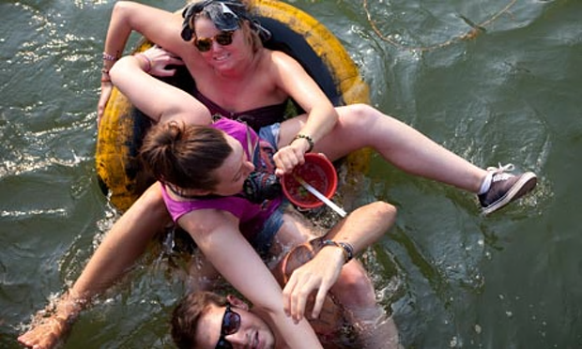
Type of unexpected events: Negative
66
Incidents
Group fights
Participants behave badly
Itinerary
A site is closed
Festivals/community gather – causes traffic
Bad road conditions
Bad traffic
Road accidents causing delays

Slide 67
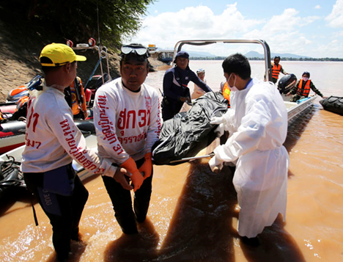
Type of unexpected events: Negative
67
Injury, accident or death – involving:
A tour group member
A staff member
A member of the public
An animal
Environmental
Bad weather conditions – like:
Long-term bad weather, e.g. rain, heat, wind
Bad weather conditions in a near-by area (e.g. typhoon in Vietnam) which will affect the actual tour area or the tour itself: e.g. flooding.

Slide 68
Type of unexpected events
68
Natural weather or other event that’s unique and interesting: special sunset
Positive events
Unexpected cultural activity – wedding, parade, festival, special market, boat race, etc.
Seeing special wildlife – doesn’t normally take place
Opportunities for engagement with an activity that’s not on this tour itinerary, but which has been part of another tour.

Slide 69

Type of unexpected events
69
Never allow tour group members to do something which has not been risk assessed, tested and approved by the tour operator.
Positive events

Slide 70
Activity 7: Unexpected Events
70
Think about tours you have done
Identify/ look for
  3 negative and
  3 positive events
you have had to allow for.
What did you do about these events?

Slide 71
Handle negative events
71
Adjust the tour for a negative event:
1. Tell pax immediately
What the event/incident is
2. Decide how to respond: different ways :
Use a Contingency plan (approved by the TO/DMC)
Use your own knowledge and common sense
3. Give pax a choice
4. Inform pax of new arrangements
Changes to itinerary
What will have to change on the itinerary
Tell them how this event impacts the tour and itinerary
Use Emergency Management plan from TO/DMC

Slide 72
Handle negative events
72
Options for changes to the itinerary
Drop the activity and replace with another one of the same type of value, quality and experience.
NB: only with TO/DMC approval!
Go faster with activities or commentaries
Only take a few questions from clients

Slide 73
Handle negative events
73
Be positive and ‘sell’ the new plan to the group telling them:
Worries about their safety
Need to stay on time
How wonderful the new, replacement activity is ☺
Arrangements (refunds, discounts, free tour) where a planned activity cannot be done

Slide 74
Handle negative events
74
Management issues!
Immediately tell management and others who need to know (attractions, restaurants, hotels, etc.) of changes – and reasons for changes:
Update them about changed times and/or non-arrival
Always follow management/organisational policy and practice – Never go beyond authority you have as a Tour Guide – often decisions are up to you but must be approved by Management

Slide 75
Handle negative events
75
Important:
Always remember ‘cost’
Time is money!
Any change from approved itinerary may cost the Tour Operator or someone else some money

Slide 76
Handle negative events
76
You may not:
You may:
offer ‘anything & everything’ to make up
Make a tour longer than the finish time
provide extra items (food, drinks) without limit
Offer what’s in your authority to offer, unless management says something else

Slide 77

Handle negative events
77
You may have to:
Change the timing of the tour – for example:
  Arrival times at destinations
  Travel times
  Total duration of the tour
  Ending time

Slide 78
Handle positive events
78
What you could do:
Stop, pause or delay – while participants watch, see or experience the unexpected event
Tell them about the event based on own knowledge – or find out more information quickly
Explain why the event is so special e.g. only once a year

Slide 79
Need to learn Tour Operator procedures
79
SOPs
Standard Operating Procedures
Contingency Plans
Handle situations where a planned itinerary, routes, activities and other cannot be followed or where a serious emergency happens
Emergency Plans
Learn, practice and be able to do all emergency plans – to address emergencies which might happen on tour

Slide 80
Practical Implementation requirements
80
Tour Guides must:
Meet tour operator contract commitments
Remember Duty of Care responsibility
Know terms, conditions & content – this info is important for anything you do
Record incidents & keep accurate tour records
Report and write down any unusual happenings
Ensure activities are performed under safe conditions and good practice

Slide 81
Types of plans
81
Tour Operators have three types of plans for their tours and activities:
Operational plans
Emergency plans
Contingency plans
(Back-up plans)

Slide 82
Contingency plans: Back-up plans
82
A contingency is:
An event that may happen or may not happen
A possibility that must be planned for

Slide 83
Contingency plans
83
These events are not ‘emergencies’ (they do not put life or property in danger) but they can :
Disrupt a tour
Disappoint tour group members.
Contingency Plans
For when things don’t turn work like you wanted
Plan A
Plan B
Plan C

Slide 84
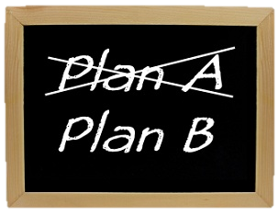
Contingency plans
84
Example:
Plan A
(the itinerary)
Elephant ride
Plan B
(the backup plan)
If it rains, do museum tour (rain may clear and do elephant ride later)

Slide 85
Why we have Contingency Plans
85
Help tours run smooth even when there are problems
Control costs, time and activities when you cannot follow the normal plan
Help meet customer expectations even where unexpected situations happen
Guide to tour staff when things go wrong or do not go as planned/expected
Meet laws about a tour that does what it promised in its advertisements.

Slide 86
When to use a contingency plan
86
Bad weather that prevents a planned activity
A site or attraction is unexpectedly closed
Closed Road stops or delays you getting to where you need to go (e.g. landslides)
Delays e.g. pax return late to a meeting point– so you can’t follow the itinerary in time left
Change in group size

Slide 87
Contingency plans
87
Who to tell if you have to use a contingency plan:
Management/Head Office
Suppliers (e.g. hotel, restaurant)
Other tours/Tour Guides
Your tour group!

Slide 88

Contingency plans
88
Contingency plan may affect other activities or itinerary, and cause:
Have to complete reports
Changes to the itinerary
Buy extra supplies or resources
Changes to other interpretive activities

Slide 89
Topic Four
Handle Complaints
What are complaints?
Understand expectations
Recognise and respond to complaints

Slide 90
Where do complaints come from?
90
Client Expectations
Complaint!
Unmet Expectations

Slide 91
Complaints
91
To have some complaints is normal – we can deal with it professionally. Tour operators anticipate:
1 minor complaint per 500 pax
(e.g. does not like the hotel room, doesn’t like the guide who has to be replaced, etc.)
1 major complaint or serious incident per 5000 pax

Slide 92
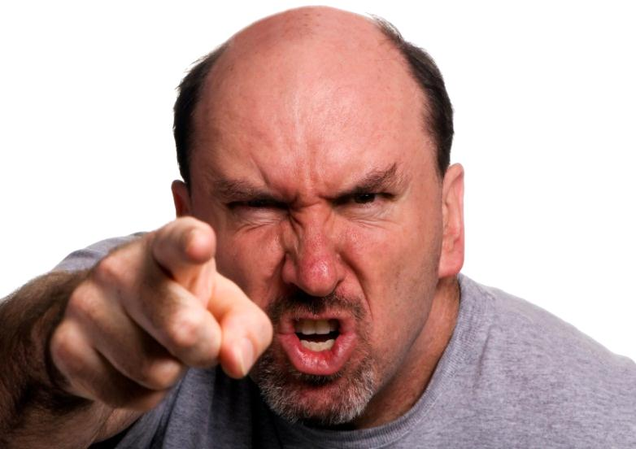
Complaints
92
We deal with professional complaints, which are about expectations not met
A client with unrealistic/ unreasonable expectations or bad/insulting manners is not considered to be a professional complaint

Slide 93
Guest expectations of all tour elements
93
Guide
Knowledge
Activities
Attitude
Service
Language skills
Logistics skills
Price-value
Experience – memories
Diversity during tour
Knowledge experience
Transport
Comfort – enough seats, no smell, window seats for photo taking
Driver skills
Duration of driving– some breaks
Safety
No repetition during tour
Interesting menu
Ambiance
Quality of service
Quality of food
Restaurant
Amenities
Service staff
No noise
Comfort
Price-value
Hotel

Slide 94
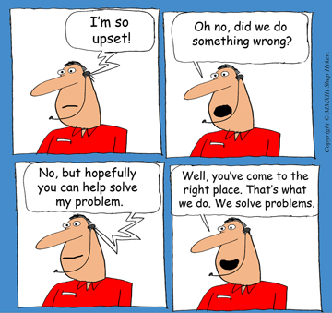
Respond to complaints
94
Customer’s problem may not be our fault, but that doesn’t mean that we shouldn’t jump to help.
That’s what the best companies do!

Slide 95
It is important to handle customer complaints
95
Negative experience has bigger impact than positive experience
Customer who has good experience tells 6 – 10 people.
Someone who has bad experience tells 10 – 15 people

Slide 96
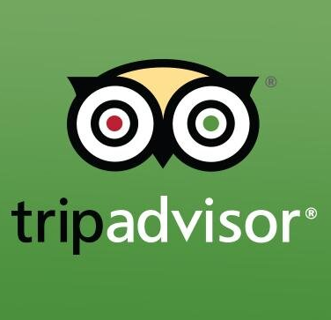
It is important to handle customer complaints
96
Tourists easily share experiences with people from all over the world – even total strangers
Negative comments/experiences will be seen & read!

Slide 97


It is important to handle customer complaints
97
Customers who’ve had a problem solved become more loyal customers than those who’ve never had any problem with a company

Slide 98
Complaints
98
Is receiving complaints a good thing or
a bad thing??

Slide 99
It is important to handle customer complaints
99
If customers tell us what they think about our services & performance, we get valuable info about our products & services
Complaints & responses tell a company:
  Where they failed to deliver expected service
  Where company can improve on service and performance
  What customers appreciate

Slide 100
Why are complaints a good thing?
100
Complaints =
Opportunity to delight & impress customers with how well we respond!
Way to make a good impression.
Let us know there’s a problem
Opportunity to create loyal repeat customers

Slide 101
Why are complaints a good thing?
101
Complaints = an opportunity:
From OUCH!!! To WOW!!!

Slide 102
How do we know about complaints
102
Our tourists
Feedback forms
Suppliers
Tour Operators
(our Clients)
Guides
Drivers
Who can tell us?

Slide 103
Helpful hints
103
It’s not what you say - but how you say it!
Be respectful and dignified
Move angry customers away from a group
Keep a safe distance between you and customer (1- 2 metres)

Slide 104

Helpful hints
104
Don’t make fun of the problem/customer but stay in a good mood
Humour can help in tough situations, but make sure it is appropriate

Slide 105


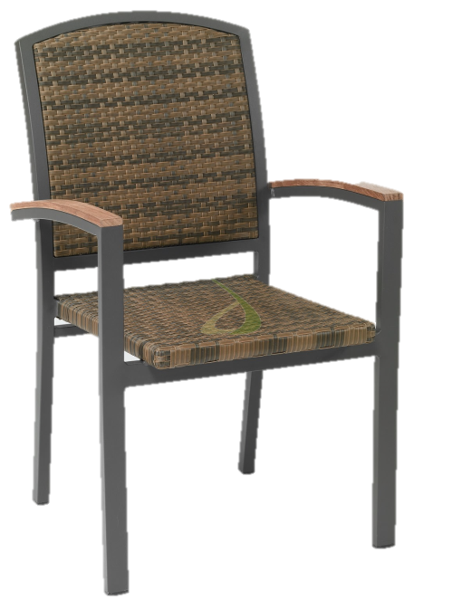
Helpful hints
105
If tourist has to wait while the problem is fixed, keep them happy! Offer:
a magazine to read or
something to drink and a
comfortable place to wait.

Slide 106

Tips
106
Very important:
Do not feel hurt or upset by a complaint!
A difficult client is usually not angry with YOU!

Slide 107
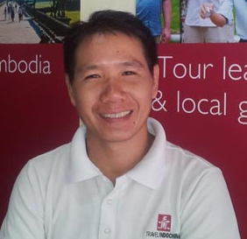

Tips
107
Even if customer refers to the company as ‘you’, and you know you personally weren’t cause of the problem, remember that customer sees you as the company!
You represent the company!
You are responsible for the reputation of the company

Slide 108

Tips
108
Focus on solving the problem
Don’t become defensive.

Slide 109

Tips
109
Don’t blame others:
That is very unprofessional

Slide 110
Activity 8: Flashcards
110
Take a flashcard
In the group, agree on the right order of the steps in the process to handle complaints.
Put these out on a table or on the floor.

Slide 111
Steps to handle complaints
111
Step 1: What is the problem?
Step 2: What caused the problem?
Step 3: What can I do to fix the problem
Step 4: How can I build rapport?
Step 5: What needs to change?

Slide 112
Step 1: What is the problem?
112
1. Listen to the complaint
2. Apologise
3. Empathise with their problem
4. Assure the customer you are going to help
5. Write down key details

Slide 113
Complaints
113
Remember:
you can apologise for anything but apologise the right way!

Slide 114
Step 2: What caused the problem?
114
Investigate situation
Determine/see if customer has a valid complaint
Apologize again if necessary
Explain what happened

Slide 115
Step 3: What can I do to fix the situation
115
1. Offer your best solution
2. Offer an alternative/extra solution
3. Tell the customer what you are doing to solve the problem
4. Take action to fix the problem
5. Make it your responsibility to help them.

Slide 116

Step 4: How can I build rapport?
116
Thank the customer for allowing you to make things right
Offer some compensation or refund
Keep them informed of progress so they know you’re doing something to help
Check up later to see if all is fine with the client and that they are happy again
Once you have taken action, tell the client the progress to fix the problem

Slide 117
Step 5: What needs to change?
117
Based on what is wrong, identify how you can prevent this in the future
Change to make things better

Slide 118
Activity 9: Flashcards
118
Take one or two flashcards
Work together, put these in 2 groups:
one of things that guides MUST do when they handle complaints, and
the other of what guides MUST NOT do when they handle complaints.

Slide 119
Handle complaints
119
Be calm Be professional Be positive Focus on a solution Try hard to resolve complaint Act as if you’re in control of situation (even if you don't feel it) Deal with it quickly & immediately | Immediately defend yourself or the company Deny anything about the complaint Blame someone else (e.g. customer or travel agent) Take complaints personally Get angry Yell or shout

Slide 120
Avoid Complaints
120
Remember that complaints come when expectations aren’t met
If you manage expectations, you can avoid complaints!

Slide 121
Activity 10: Complaint handling role plays
121
Work in pairs, each take a scenario for a role play.
Use the skills you have learned, act out the scene for your classmates.

Slide 122
Conclusion
Module summary
Assignment presentations
Course summary

Slide 123
Module Programme
123
Topic 1:
Solve Problems and Make Decisions
Topic 3:
Handle Unexpected Events
Topic 4:
Handle Complaints
Topic 2:
Identify and Manage Risks

Slide 124

Course Programme
124
Module 1: Professionalism
Module 2: Build Rapport
Module 3: Interpretive Activities
Module 4: Tour Management
Module 5: Leadership

Slide 125
Thank You! Kop Chai!

