Slide 1


Module Two
Building Rapport

Slide 2

Module Programme
2
Topic 1: Understanding our tourists
Topic 2: Communication
Topic 3: Introductions

Slide 3



Activity 1: Tuk Tuk Safaris
3
Read the sheet about Tuk Tuk Safaris, and the owner-guide, Ere.
Answer the 3 questions:
What do Western tourists really like about Ere?
What did they really like about the tours?
How does this affect Ere’s business?

Slide 4
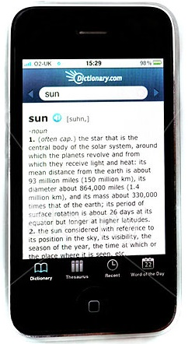
Activity 2: Dictionary search
4
Use your phones, look up the meaning of the word “rapport”

Slide 5
What is Rapport?
5
A close and harmonious relationship
in which the people or groups
understand each other's feelings or ideas and
communicate well

Slide 6
Why is Rapport important?
6
Better tour experience for:
Your tourist
You!
Better communication
Trust
Fun
To build Rapport, we need to know as much as possible about our tourists

Slide 7

Topic One
Understanding our Tourists
Why people travel
National characteristics
Do’s and Don’ts

Slide 8
Activity 3: Understanding our tourist
8
Discuss in small groups – what do you think tourists expect from a holiday in Laos?
Write up the 5 most important things you can think of and agree on

Slide 9

What do they want in Laos? To:
9
experience a different culture
explore a place that is not well known – not a big tourism destination
learn new things
have new and interesting experiences
receive good service
feel safe and secure
have a knowledgeable and skilled guide

Slide 10
Our tourist….
10
Came from far away – a long fight at high cost
Worked hard for the money to pay the trip – wants value for money
Doesn’t have much leave, so wants to experience the best and as much as possible on their trip
May be (retired) professional persons with high education who wants very good info on Laos
Is well travelled and can compare the standards of touring in Laos with many other countries in the world
Has responsible tourism values for looking after people and places

Slide 11
More about our tourists….
11
Education: usually well educated – higher expectations of a tour guide – they want good information on lots of different subjects
Interests: wide range of interests : history, culture, architecture, food, people, religion, etc.
Enquiring minds: will be curious about many things and will ask a lot of questions

Slide 12
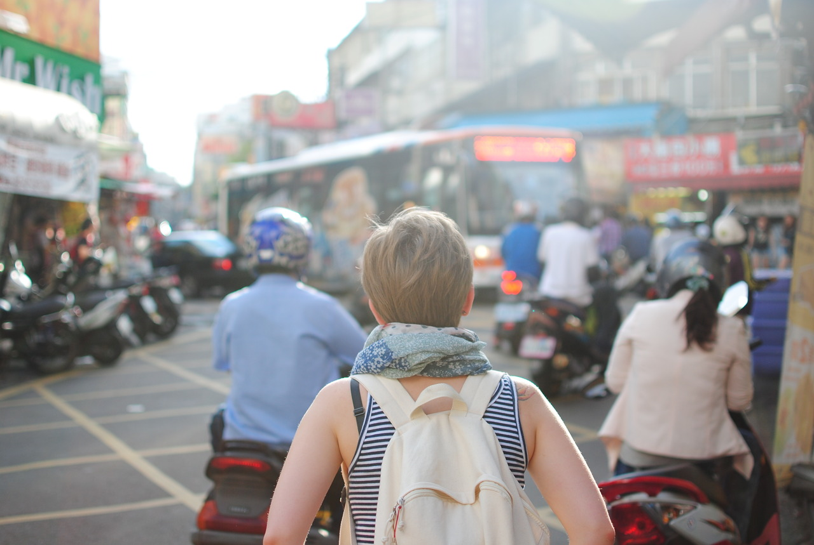
Our Tourists are…
12
Foreign country: everything = different
Culture shock
They don’t know rules - how to behave, what to say/do…
Long way from home

Slide 13
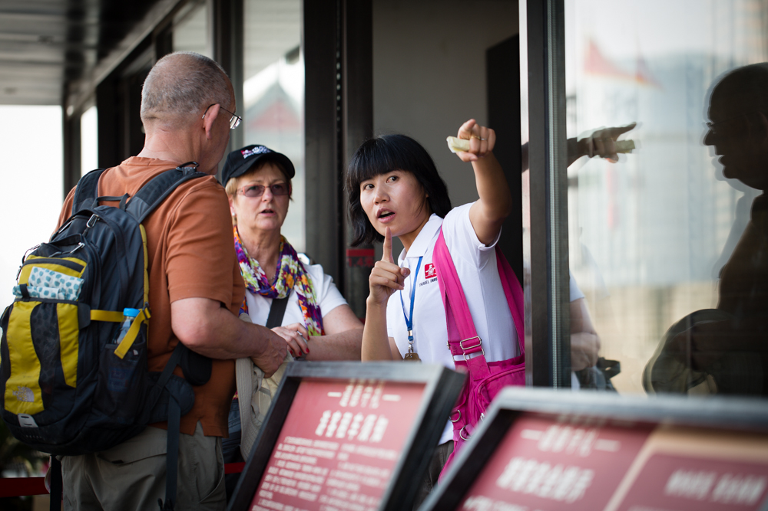
Our Tourists are….
13
You are their lifeline!!

Slide 14

Conflicts and Complaints
14
Remember: conflicts and complaints - because expectations weren’t met

Slide 15

Addressing cultural differences
15
Respect other cultures
Try hard to learn

Slide 16

Addressing cultural differences
16
Learn basic words and phrases

Slide 17

Addressing cultural differences
17
Hello
Start with basics
Thank You
How are you?
Nice to meet you
Please
Goodbye

Slide 18
Our main Western source markets
18
French
German
American
British

Slide 19
Activity 4: Nationality Characteristics
19
French
German
American
British

Slide 20
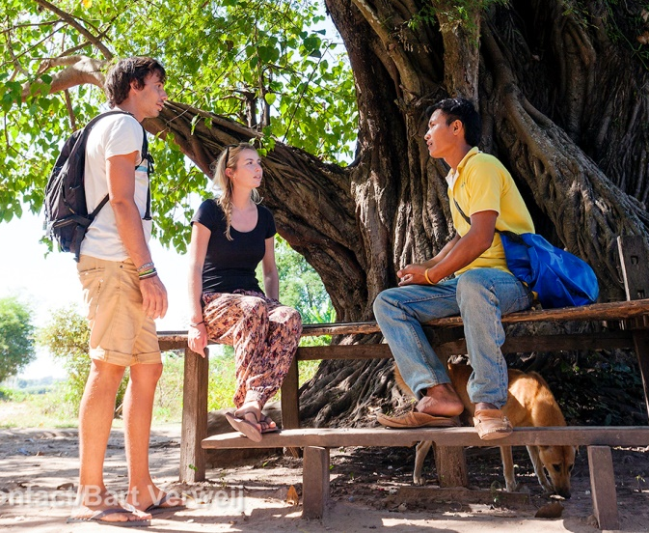
Our tourists
20
Generally they are….
Lifelong learner (always
wants to learn)
Love to travel
Love to learn about daily life
Want lots of information
Want to leave the world a better place
Willing to try new things – in a safe environment

Slide 21

The French
21
Careful with their money
Tough, independent
Punctual

Slide 22
The French
22
Likes
Polite manners
Dislikes
Lack of education
Not being straight/honest
Culture, philosophy, the big picture
Being treated like a ‘tourist’
Local food
Cleanliness
Being badly dressed and presented

Slide 23
The French
23
Do’s
If there is a problem, immediately solve it
Listen to complaints & find a quick solution
Don’ts
Think that people mean what they say
Accept if they invite you to their table for a meal
French can say things to be polite, but are not serious about them

Slide 24

The German
24
They come from far away
Expect everything to work very well
Not very warm personalities
Well organised
Can appear to be rude
Respect traditions and culture
Like drinking!

Slide 25
The German
25
Likes
Straight/well-said communication
Factual to the point info
Dislikes
Lateness, running behind schedule
No covering up uncomfortable truths
Punctuality
Clean and orderly hotels and restaurants
Non-communication about what is happening
Making up facts
Doing too much
Too much unnecessary service
Beer!

Slide 26
The German
26
Do’s
Tell them the facts
Don’ts
Leave out uncomfortable info e.g. government, politics, royal family
Over-communicate/ talk too much

Slide 27

The British
27
Independent
A bit arrogant (high ego)
Organised
Aware of safety issues
Very demanding/
needy

Slide 28
The British
28
Likes
Warmth
Learning new, interesting things
Dislikes
Taking risks
Too much information
Mosquitos
Noise
Being touched
Their own food
Hygiene and cleanliness
Fun and entertainment
Good table manners

Slide 29
The British
29
Do’s
Ask what they want you to call them: older pax can be very formal
Understand that they are part of a multi-country SEA tour
Don’ts
Be too casual with older British pax
Take offence at their humour
Recognise sarcasm is part of their humour
Talk about personal matters
Talk about sports

Slide 30
The British
30
What is ‘sarcasm’?
A ‘nasty’ remark that is supposed to be funny.
When someone says the opposite of what they really mean.
Examples:
When something bad happens: “That's just what I need, great! Terrific!”
When you expected something to happen, especially after warning someone about it; “Well what a surprise!’
When someone says something that is very obvious or stupid; - Really? No! You are so clever!”
When someone does something wrong: “Very good, well done, nice!”
When something happens that you don’t want or need: “That's just what we need!”

Slide 31

The American
31
Very demanding travellers
Even older Americans are young at heart
Fun, entertaining
Like to show off a bit
Careful with their money, but still generous

Slide 32
The American
32
Likes
Very high service expectations
Willing to try new foods
Dislikes
Bad guides
Asking about age
Walking too long
Stepping out of comfort zone: e.g. risk taking, food, activities, etc.
Children
Safety
Pets

Slide 33
The American
33
Do’s
Mostly first time visitors to Asia – help them with culture shock!
Know less about Asia than pax from other countries – will need info
Don’ts
Talk about personal matters e.g. marital status, weight, age, income etc.
Go the extra mile!
Recognise that service expectations are very high

Slide 34
Ideas for Building Rapport
34
Ways to build Rapport

Slide 35
Ideas for Building Rapport
35
When and Where?
Start of the day: at breakfast
Call to room after check-in to see if everything is OK
Chat during meals
In the vehicle
During activities
During free time: e.g. give ideas on what to do
Ask feedback in general – about the day, the activity, during the trip, etc.
Repeat a question from a single tourist, and tell the whole group. E.g. “Lisa just raised a good question”

Slide 36
Ideas for Building Rapport
36
Build on conversations when you greet people:
Mention a previous topic of conversation
Remember & use name
Check that a query has been resolved

Slide 37
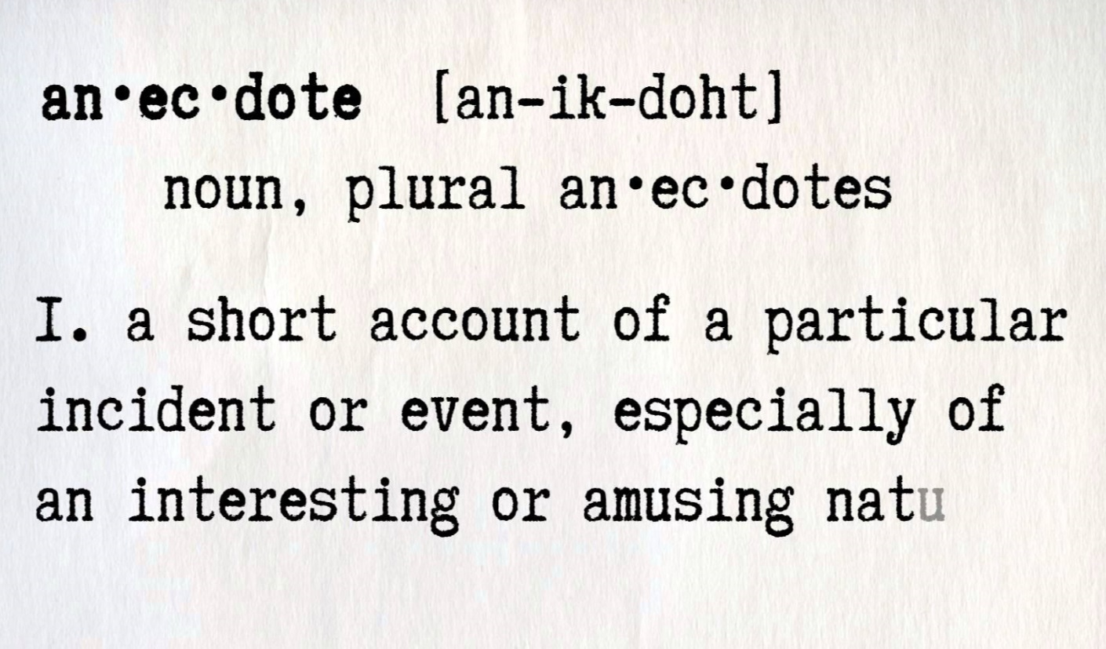
Ideas for Building Rapport
37
Use anecdotes
Relevant to site, location or tour
Adds interest and insight.

Slide 38
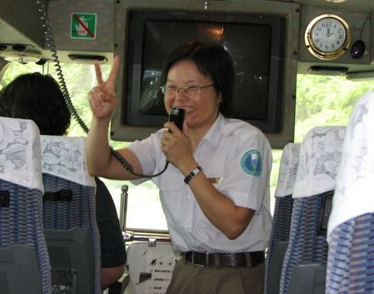
Ideas for Building Rapport
38
Use humour
Appropriate humour at appropriate times
= fun and enjoyment

Slide 39
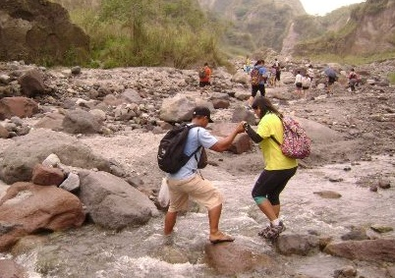
Ideas for Building Rapport
39
Check people’s welfare
Ask if they need anything
Make sure they are okay and prepared
Help them to solve problems

Slide 40





Ideas for Building Rapport
40
Respond to questions
Eye contact
Smile
Interpersonal communication skills
Clarify info
Show interest

Slide 41
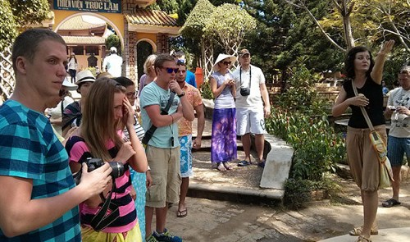
Ideas for Building Rapport
41
Involve your tourists
Tell them what is going to happen
Give them something to do
Give them something to look at or read

Slide 42
Ideas for Building Rapport
42
Finding out Tourists’ needs and interests

Slide 43
Linking to tourists needs
43
Country: where are they from?
Culture
Education: levels?
Age: how old are they?

Slide 44
Example: linking to their Home Country
44
Pound Sterling: £
Metric and imperial
USD: $
Imperial: Pounds, ounces, gallons, miles
Euro: €
Metric system kg, km, etc.
Yen: ¥
Metric system kg, km, etc.

Slide 45


Useful Apps for guides
45
Unit Converter
App by Mobitrendz
Distance calculator App

Slide 46
How to find out their needs
46
Watch
Listen
Answer questions

Slide 47
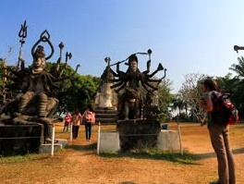
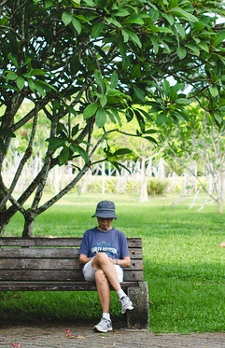
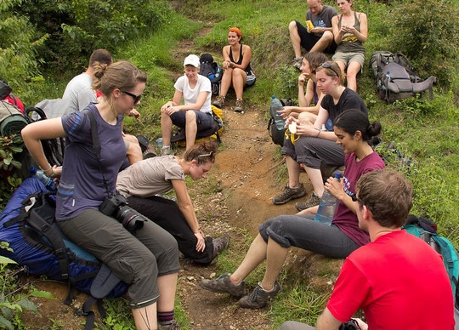
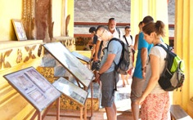
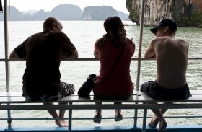
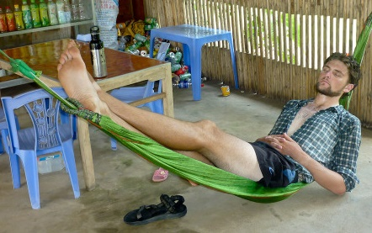
Accommodating needs and wishes
47
Time for a rest
Personal enjoyment of the site
Time for people to chat
Quiet time
Free time

Slide 48
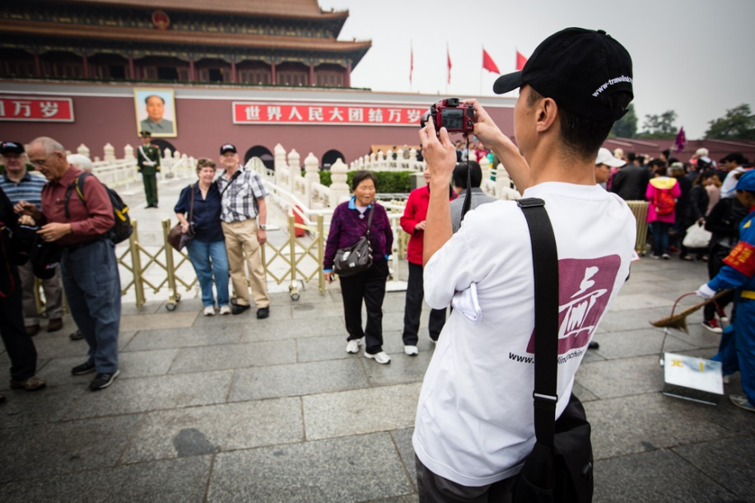
Accommodating needs and wishes
48
Photo opportunities:
Special moments
Tourists always want photos

Slide 49
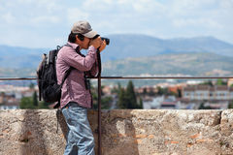
Accommodating needs and wishes
49
Photo opportunities:
If they can’t take photographs = complaint
Try to give them lots of opportunities
Extra time for photos
Offer to take photos
Hold bags/other items
Be in the photo

Slide 50
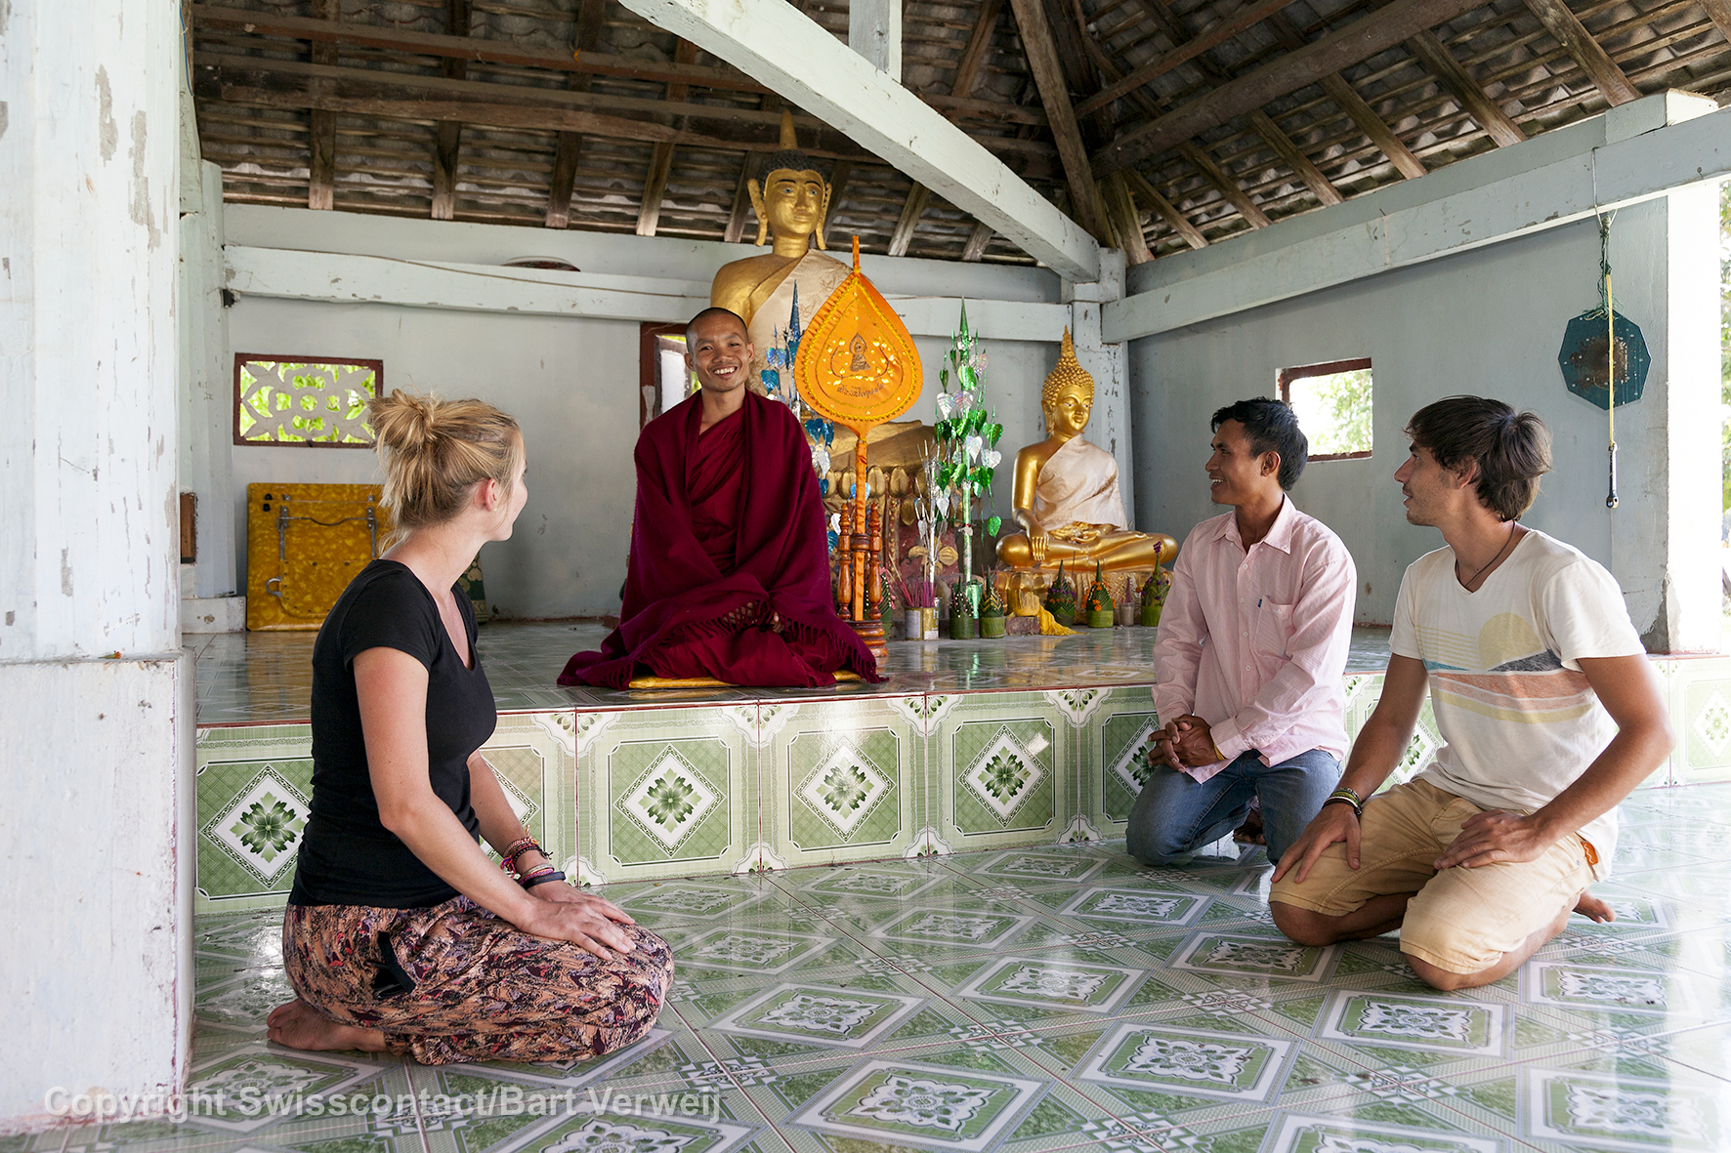
Personal interaction opportunities
50
‘Up close and personal’ opportunities…
Special access to ‘off limits’ area
Meet staff/ people @ site/venue
Special introductions and more contact (time) with special people… in villages, etc.
Special photo opportunities

Slide 51
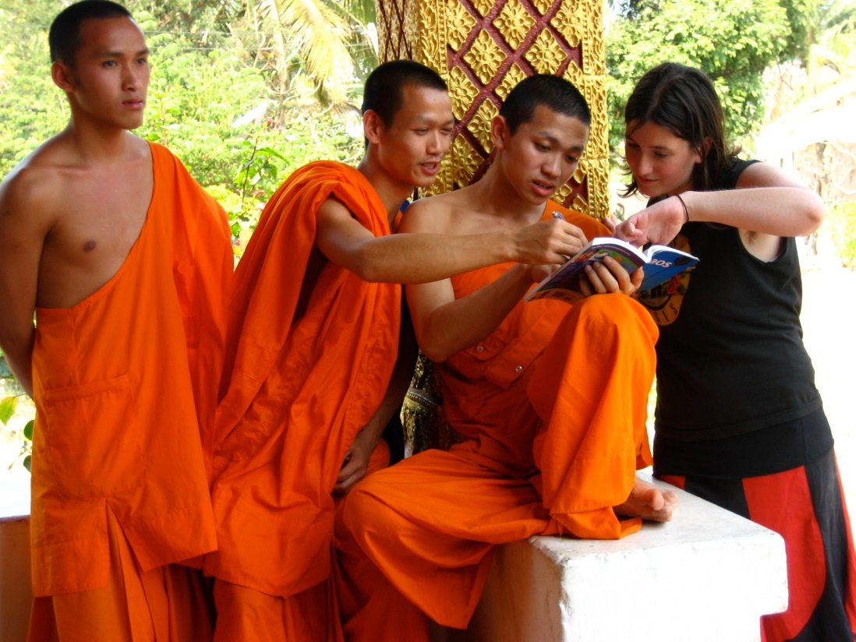
Personal interaction opportunities
51
Special people:
Village leaders
Chief of village
Midwife
Monks
Governor
Shaman

Slide 52
Personal interaction opportunities
52
Cannot always plan these opportunities… some happen by chance along the way: how to:
Usually no cell numbers for these people
Ask local people where to find special people
Find them and ask permission to engage with them – in their home, talk to tourists, etc.
Tell tourists how to behave: photos or not, shoes off, safety – low doorways, etc.
Introduce them, help with communication - interpret

Slide 53
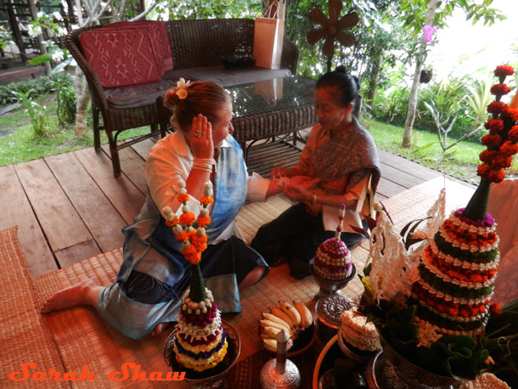
How to make this happen
53
When:
Can arrange special meetings with such people in free times as an extra opportunity, e.g.
  Meeting with monks;
  Alms giving ceremony, etc.
This is often a highlight of a tour to the tourist!!!

Slide 54

Special Treatment
54
Special treatment – often small things
First onto transport
Gets food first
‘Best’ seats’ at meals
Front of lines/queues
Sit together for meals/refreshments

Slide 55
Special interest groups – Interested in:
55
Food
History
Nature
Architecture
Arts and culture

Slide 56
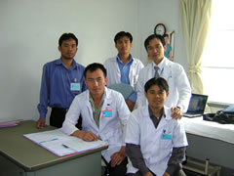
Special Groups
56
Professional or special groups, e.g.:
Doctors
Lawyers
Deaf people
To Do: examples
Do background research on the medical or legal system in Laos so you can answer questions and understand their interests
Organise meetings with local medical people if possible

Slide 57
Special interest groups
57
Do homework to add content to commentary:
Facts and statistics
Info and detail
Anecdotes
Comparisons
Prices
Dates
Examples

Slide 58

Specialist groups: Briefing includes:
58
Briefing from Ops Department:
Reason for visit
Interests
Where to find info?

Slide 59


Don’t take offence!
59
Tourist’s culture is different to yours – don’t take offence!
Action | You | Tourist
Show feet
Step over someone
Eat with mouth open
Spit on street

Slide 60

Don’t take offence!
60
If something upsets/offends you – think :
Were they trying to offend you?
Are you taking it personally because of your culture?
Try to tell the difference :
Helps you to avoid difficult/ unhappy situations

Slide 61
Suitable conversation topics
61
Stay with general info and topics: weather, sports, events, etc. Ask about families, children, etc. | Ask women their age Ask how much money people earn Say rude things about groups e.g. homosexuals, vegetarians, different religions, ethnic groups, etc.

Slide 62
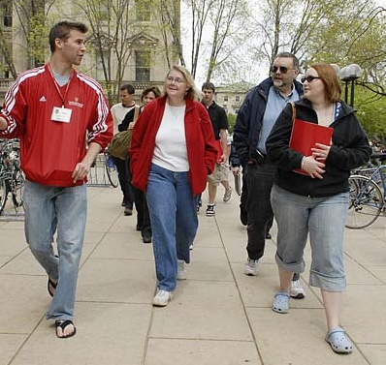
Types of questions
62
Where do you live?
Why are you on this tour?
Tell me about you family?
Have you been on tours before?
What interests you?
How was the experience?

Slide 63
Topic Two
Communication
Process of communication
Barriers to communication
Types of communication

Slide 64
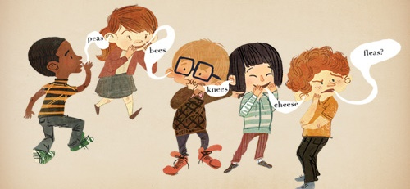
Activity 5: Broken Telephone
64
Stand in a semi-circle
The trainer will whisper a message to the first person in the line
This person will whisper it to the next person, who will whisper it to the next person.
The last person must say it out loud for the whole group to hear.
Was this successful or unsuccessful communication?

Slide 65




Why communicate?
65
COMMUNICATION
To get
People to do
something
To make people
understand
To get and
give
Information

Slide 66

Communication process
66
Message
Receiver
Sender
To sender
from receiver
From receiver
to sender
Feedback

Slide 67
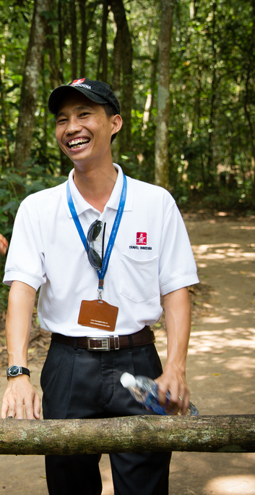
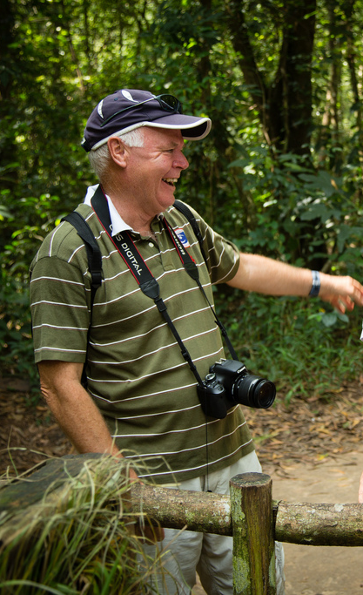
Communication… getting the message over
67
Successful communication?

Slide 68
Communication… getting the message over
68
Message
Verbal: Written or spoken Non-verbal: Expressions Body language Tone of voice Gestures

Slide 69

Unsuccessful Communication.
69
Barriers
Sender
Receiver
Message
To sender
from receiver
From receiver
to sender
Feedback

Slide 70
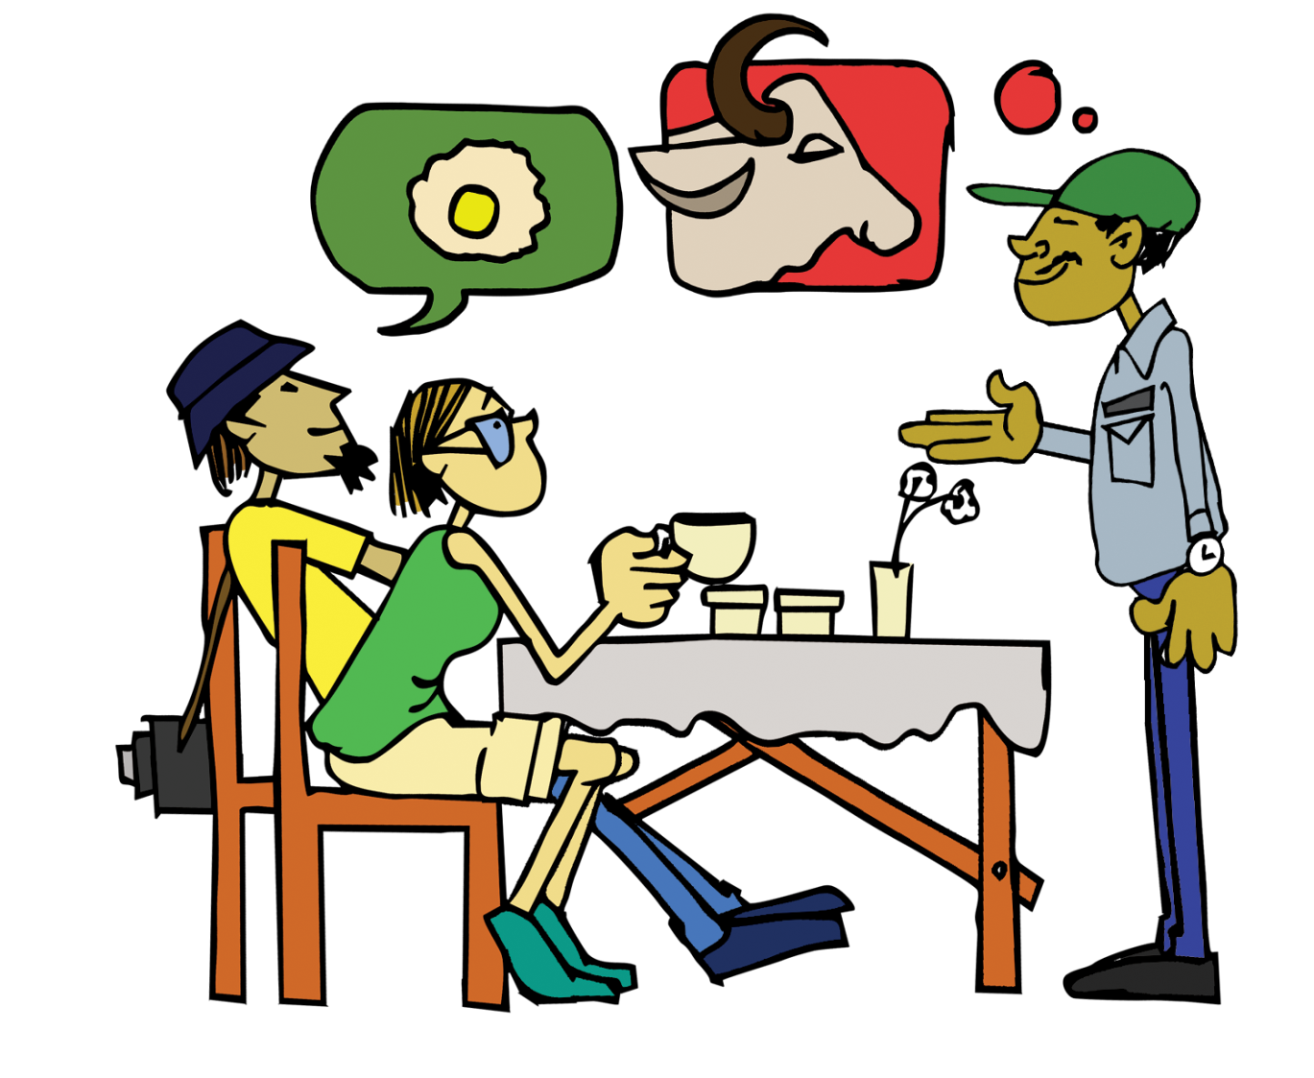
Barriers to communication
70
Most barriers are:
Cultural
Language
Physical
If you can’t use words,
learn and use signs,
gestures and symbols

Slide 71
Barriers to communication
71
Noise: traffic, people, etc.
Language: different understanding of words
Accents: how words is said: PRACTICE!! Learn!
Culture: some cultural ways may offend others: e.g. British sarcasm
Physical: wrong interpretations of body language

Slide 72




Types of communication
72
COMMUNICATION
Non-verbal
Verbal
Symbols,
pictures,
signs
Gestures
Spoken & written
words

Slide 73


Non-verbal communication
73
Body Language
We can communicate
without words!
link
Gestures
Non-Verbal Communication
Pictures
Symbols

Slide 74






Signs and Symbols
74
B
C
A
D
E
F

Slide 75






Signs and Symbols
75
G
H
I
J
L
K

Slide 76
Activity 6: Gesture Game
76
Your trainer will give you cards with gestures you may get from tourists
Take turns to do these
Your classmates must try to identify what the gestures mean.
Learn the correct gestures so that you can identify them when your are working

Slide 77
Body Language
77
A form of non-verbal communication
A guest can show how they feel with the actions of their bodies
We need to read these to identify a guests’ mood and respond to it in the right way
What are the guests telling us in the next slide?

Slide 78
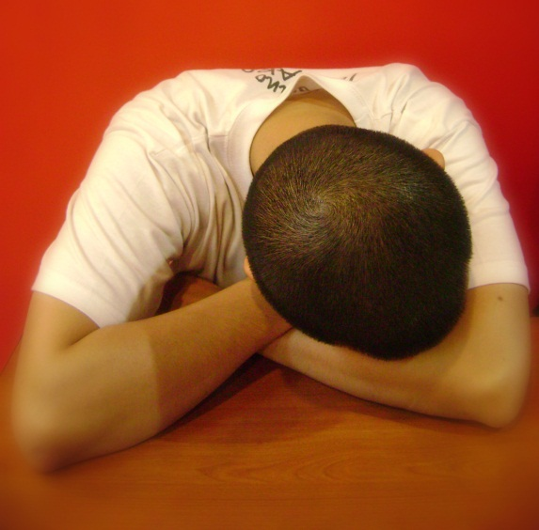
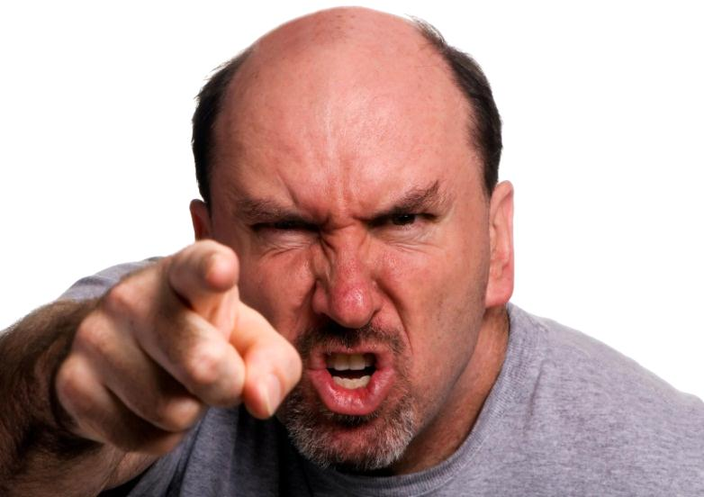
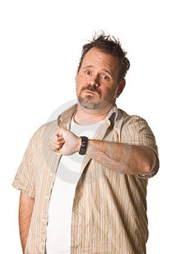
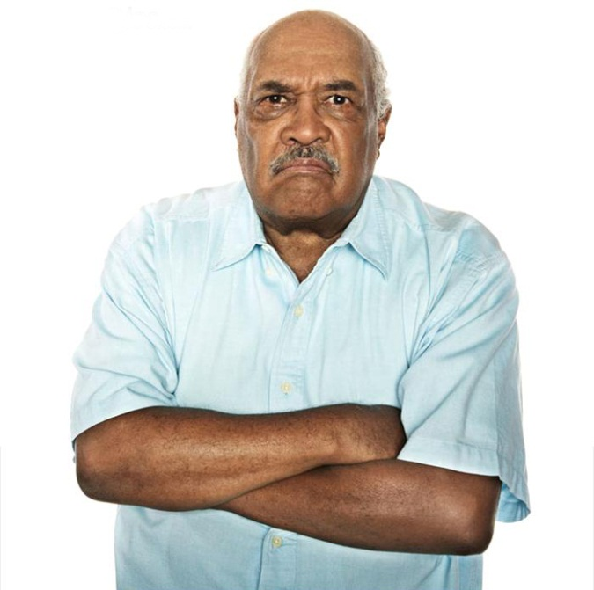
What are these guests telling us?
78

Slide 79
Western Interpretation of body language
79
Eye contact
No eye contact
Look around, break eye contact, dart eyes around
Close eyes
Rub eyes
Narrowed eyes
Roll their eyes
Raise eyebrows
Hand over the mouth
Thin folded mouth
Tilt head to the side
Clearing throat
Restless hands, drum fingers
Tap feet
Rub hands together
Hands in fists
Use hands with downward facing palms
Arms crossed across chest
Bad posture – shoulders drooping
Look at their watch
Look at their watch

Slide 80

Remember
80
Your body language says a lot about
YOU!
Your tourists will be watching you too!

Slide 81
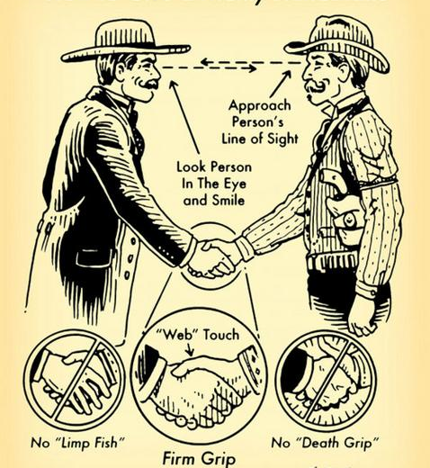
Handshakes
81

Slide 82
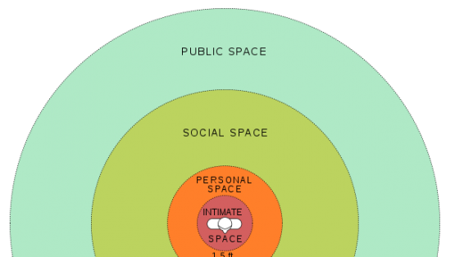
Personal Space
82

Slide 83
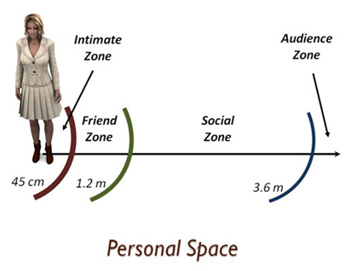
Personal Space
83

Slide 84

Communication tips
84
Don’t stand too close
Eye contact
Firm handshake
Full attention
Smell nice
Non-verbal feedback
Suitable greeting
Moderate tone of voice
‘Open’ body language

Slide 85
Topic Three
Introductions
Introduce yourself
Introduce tour members

Slide 86

Greet and welcome tourists
86
Be prepared and be there
Meet and greet - a friendly smile
Booking checks
Gather and welcome members
Start on time, even if there are latecomers

Slide 87
Why introduce yourself??
87
Build trust between guide and tourist
Open yourself to the travellers
Start building rapport
Make a geographical connection – where are you from.
Build tourist confidence in your skills and experience as a guide
Give a bit of background on Laos

Slide 88
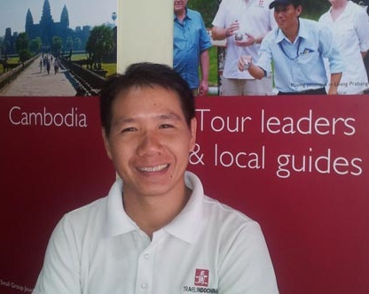
Introduce Self
88
Create the right impression through:
Information about YOU:
Right type and amount
Formality:
Right level
Role/responsibilities:
Be clear!
Do not overpromise!!
Rather under-promise and over-deliver

Slide 89
Introduce Self
89
Contents of intro:
Name
Welcome to the tour and country
Where you come from
Your credentials: qualification and experience
Your time with the company
What you will do
What you cannot do
Availability
Conclusion

Slide 90

Introduce Self
90
My name is…..and I’ll be your tour guide today/for the next duration

Slide 91

Introduce Self
91
On behalf of Adventure Tours I’d like to welcome you to the Amazing Laos Adventure Tour!

Slide 92

Introduce Self
92
Thank you for choosing our wonderful tour; we hope that we will provide you with an “Amazing Laos” experience!

Slide 93

Introduce Self
93
I come from _______
(mention/show on map and make a link to something interesting from that part of the country – e.g. Ho Chi Minh trail, which we will look at more closely later in the tour)
This creates curiosity and openness to questions during the tour

Slide 94
Introduce Self
94
I’ve been a tour guide in Laos for ___years. I studied ___ for___years in Vientiane, and I specialise in _____ tours.

Slide 95
Introduce Self
95
I’ve been a ______Tours Guide for the last ___ years, and I love my exciting job!
I’m proud to represent my country and culture, so please don’t hesitate to ask me questions about Laos!

Slide 96

Introduce Self
96
My job is to show you our beautiful country and share what I can about it. I will help you with the organised activities on our itinerary.

Slide 97
Introduce Self
97
If there are other activities you would like to do in your spare time, you can ask me where to arrange these for you, but I will not be leading those.

Slide 98
Introduce Self
98
I will also not be driving you – for that we have an experienced driver, who I will introduce you to soon

Slide 99
Introduce Self
99
Availability:
Encourage travellers to engage with you and ask questions: e.g.
“I am at your service 24/7, and here is my cell number in case you need to contact me at any time…...”

Slide 100
Introduce Self
100
Conclusion:
Encourage travellers to engage with you and ask questions: e.g.
“Please don’t hesitate (wait/be shy) to ask me any questions, or let me know if you need anything along the way.”

Slide 101
Activity 7: Role Play introductions
101
Instructions:
You will each have 3 minutes to do an introduction on yourself as if you are introducing yourself to a tour group.
Watch and listen to your colleagues, and be prepared to give them some supportive feedback on:
Content of the introduction
Speed: how fast or slow
Voice: could you hear clearly
Length: was it too short or too long?

Slide 102
Conclusion
Module Summary
Next Module
Questions?

Slide 103
Module Programme
103
Topic 1: Understanding our tourists
Topic 2: Communication
Topic 3: Introductions

Slide 104

Module Three
Interpretive Skills

Slide 105
Thank You! Kop Chai!

